Slide 1
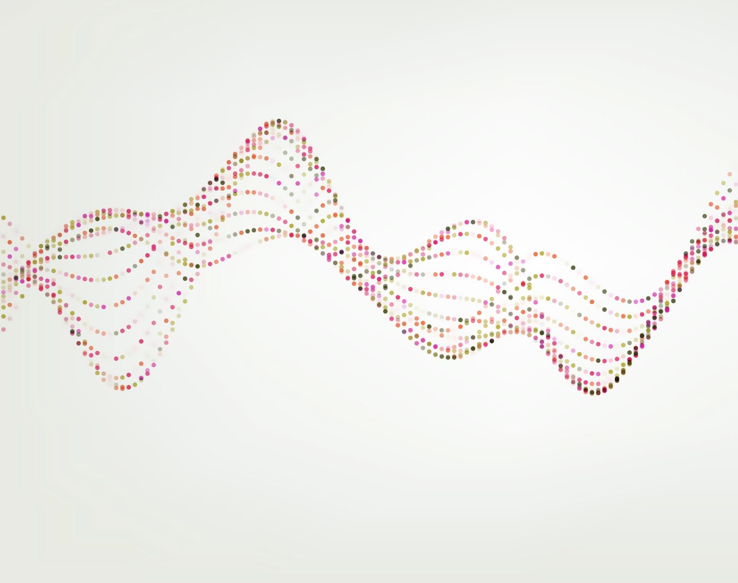
Power BI Integration with Azure AutoML Tutorial
Steve Li

Slide 2
Overview
Create the predictive model by using automated machine learning
Create an Azure Machine Learning compute cluster.
Create a dataset.
Create an automated machine learning run.
Deploy the best model to a real-time scoring endpoint.
Consume Azure Machine Learning models in Power BI
Score machine learning models (deployed using Azure Machine Learning) in Power BI.
Connect to an Azure Machine Learning model in the Power Query Editor.
Create a report with a visualization based on that model.
Publish that report to the Power BI service.
Set up scheduled refresh for the report.

Slide 3
Create the predictive model by using automated machine learning

Slide 4
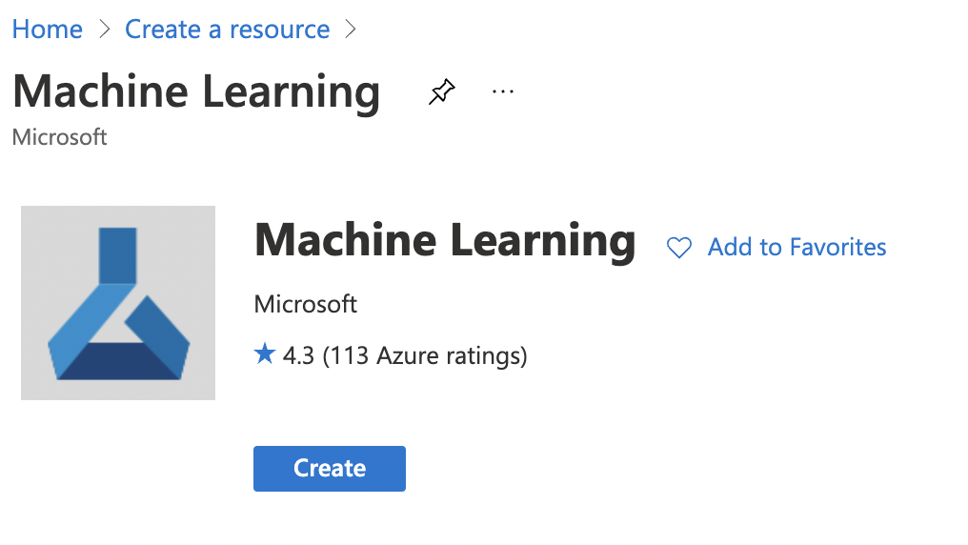
Access to Azure Cloud Computing

Slide 5
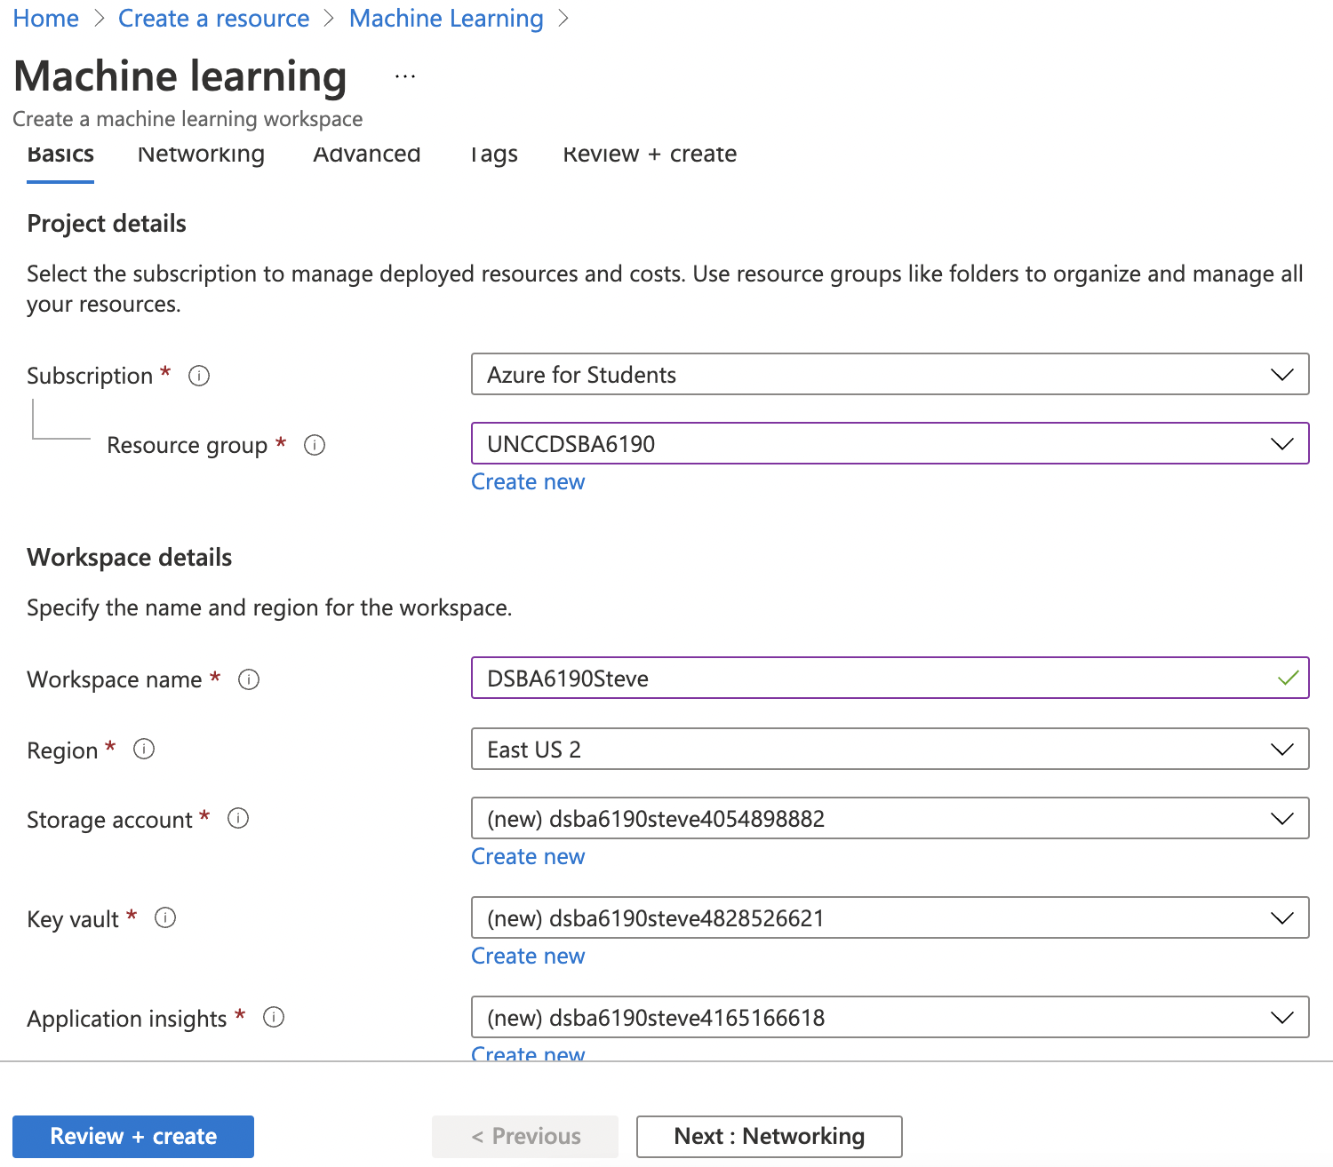
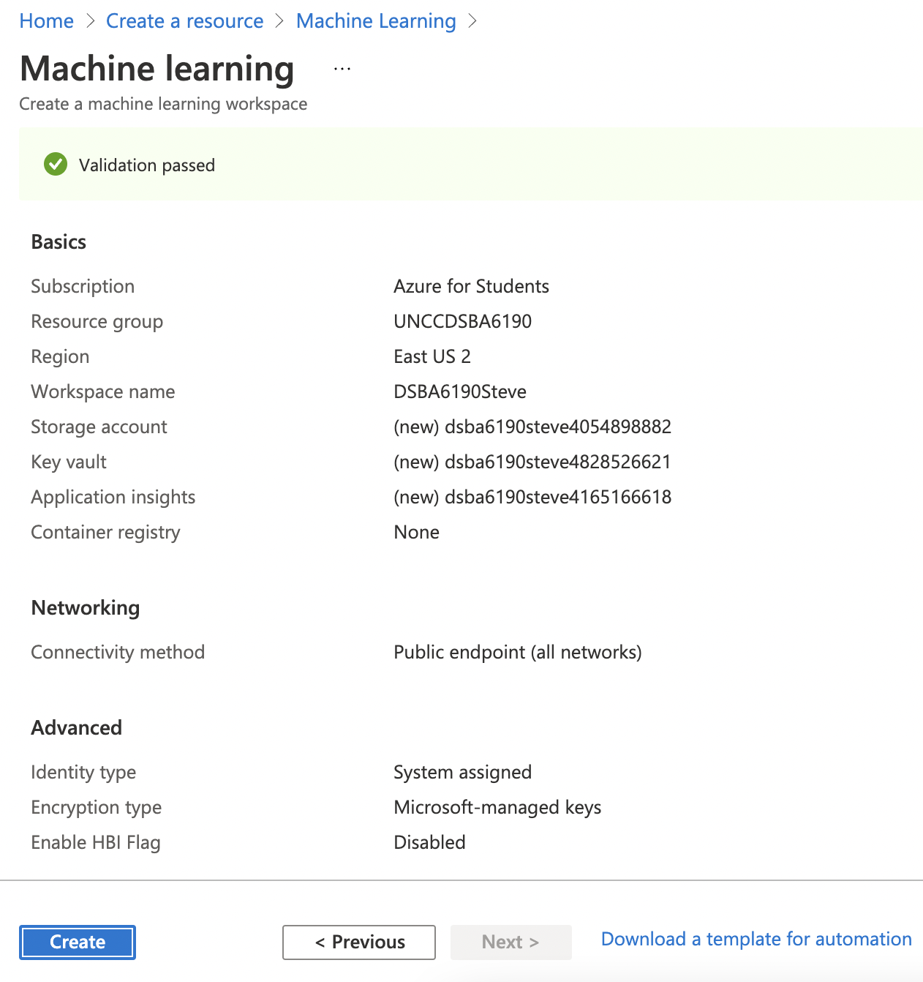
Create a Resource

Slide 6
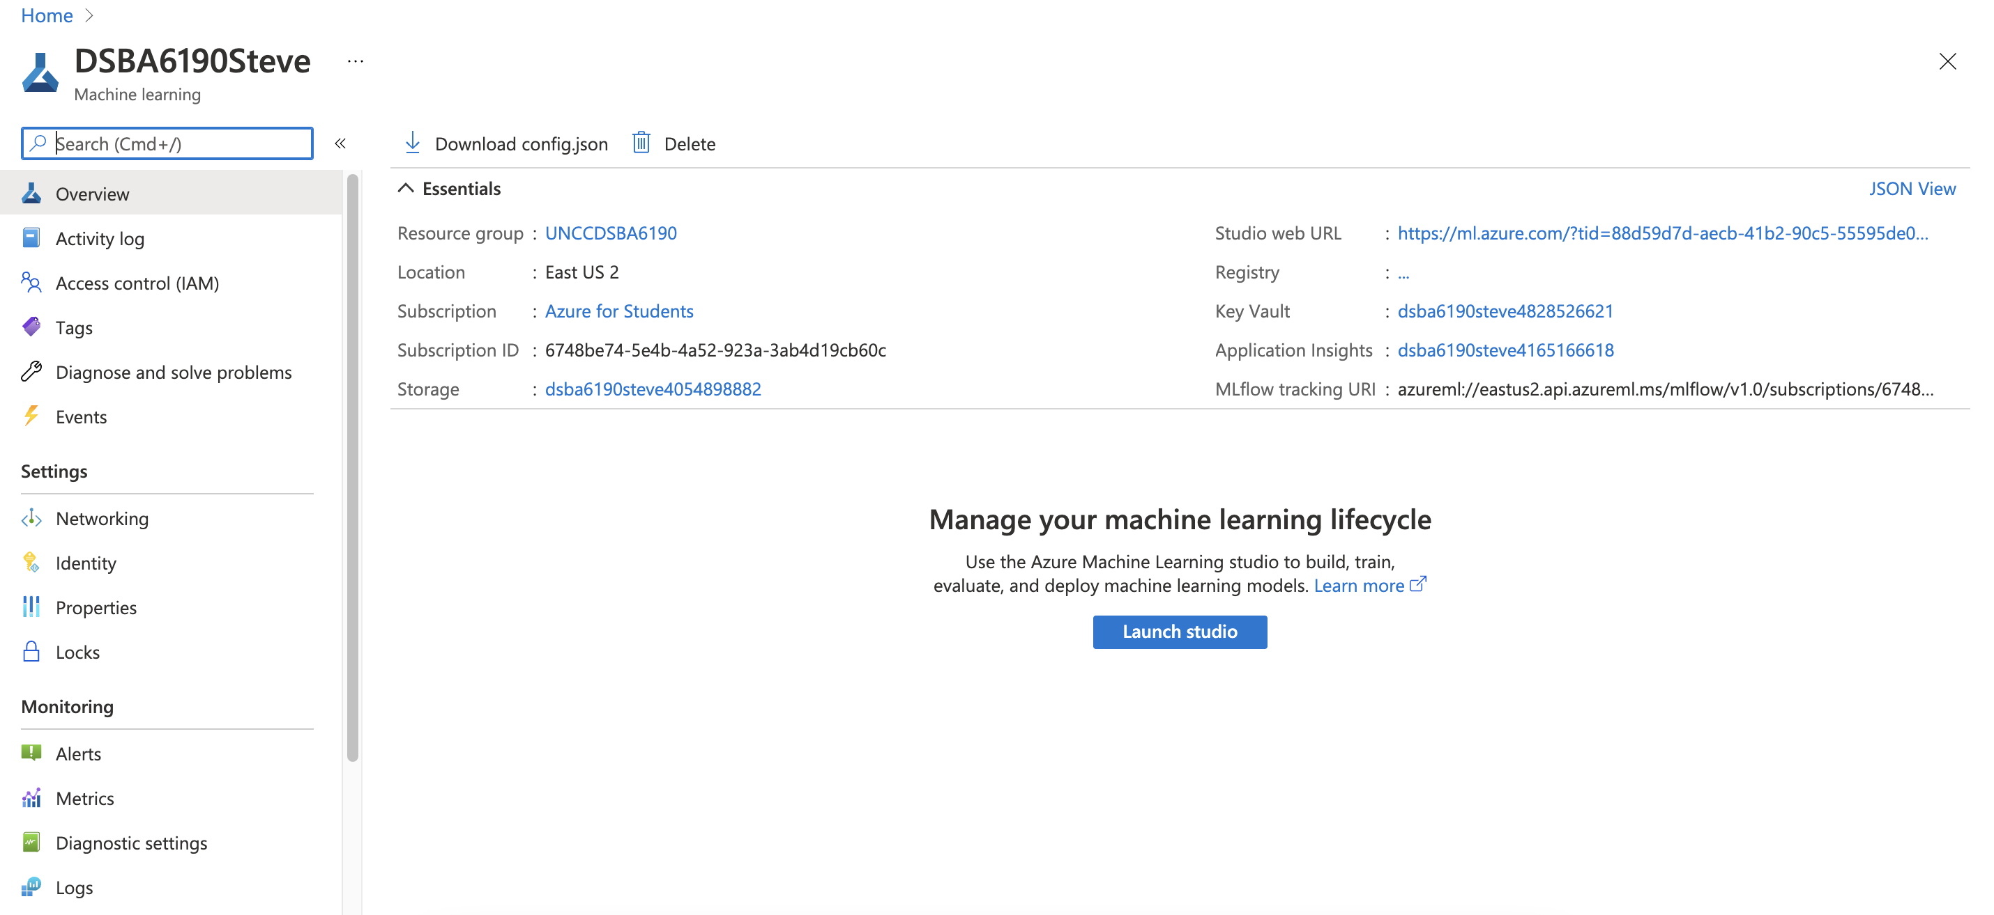
Launch Studio

Slide 7
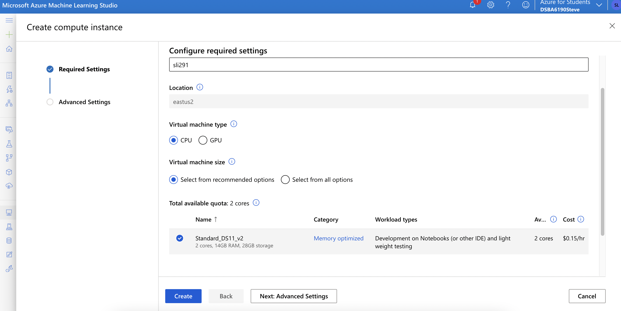
Create Compute Instance

Slide 8
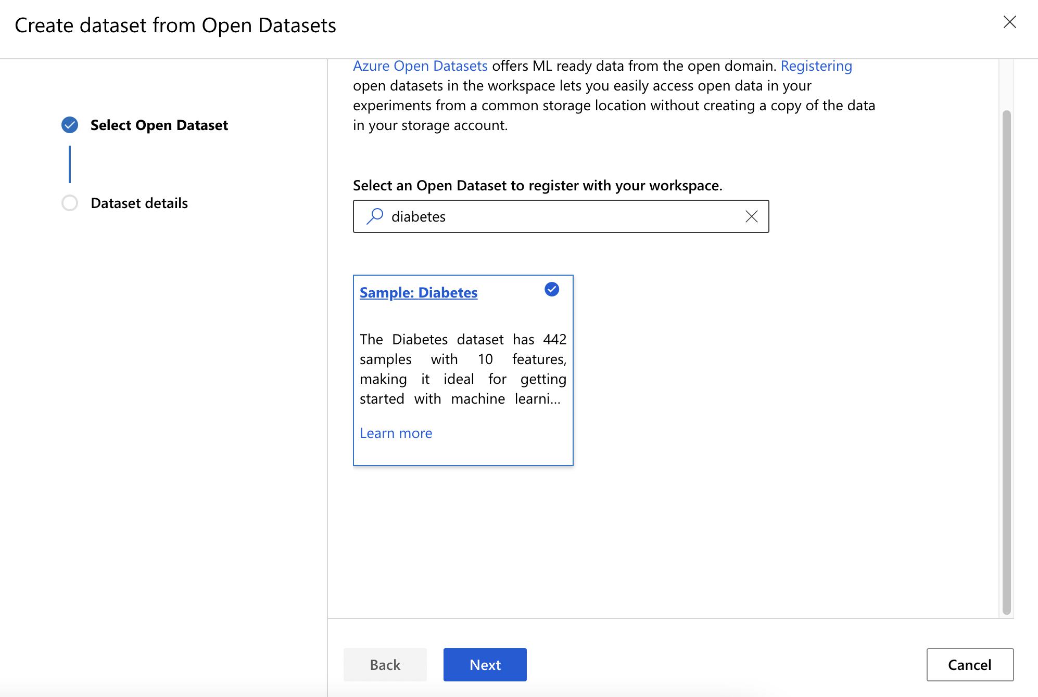
Select Diabetes Dataset

Slide 9
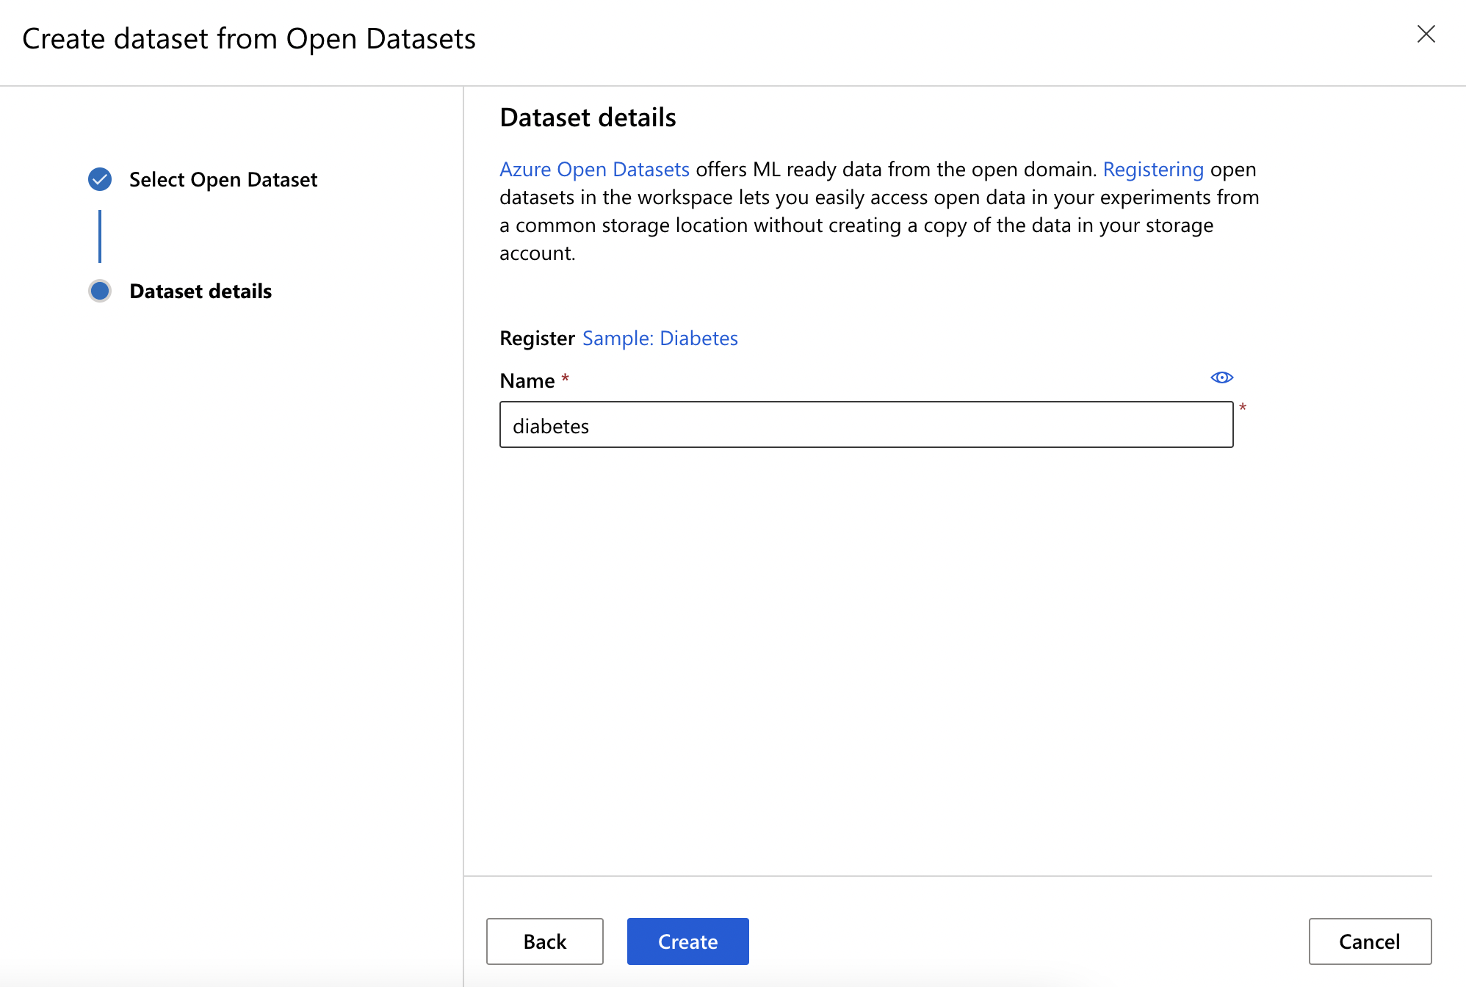
Create Diabetes Dataset

Slide 10
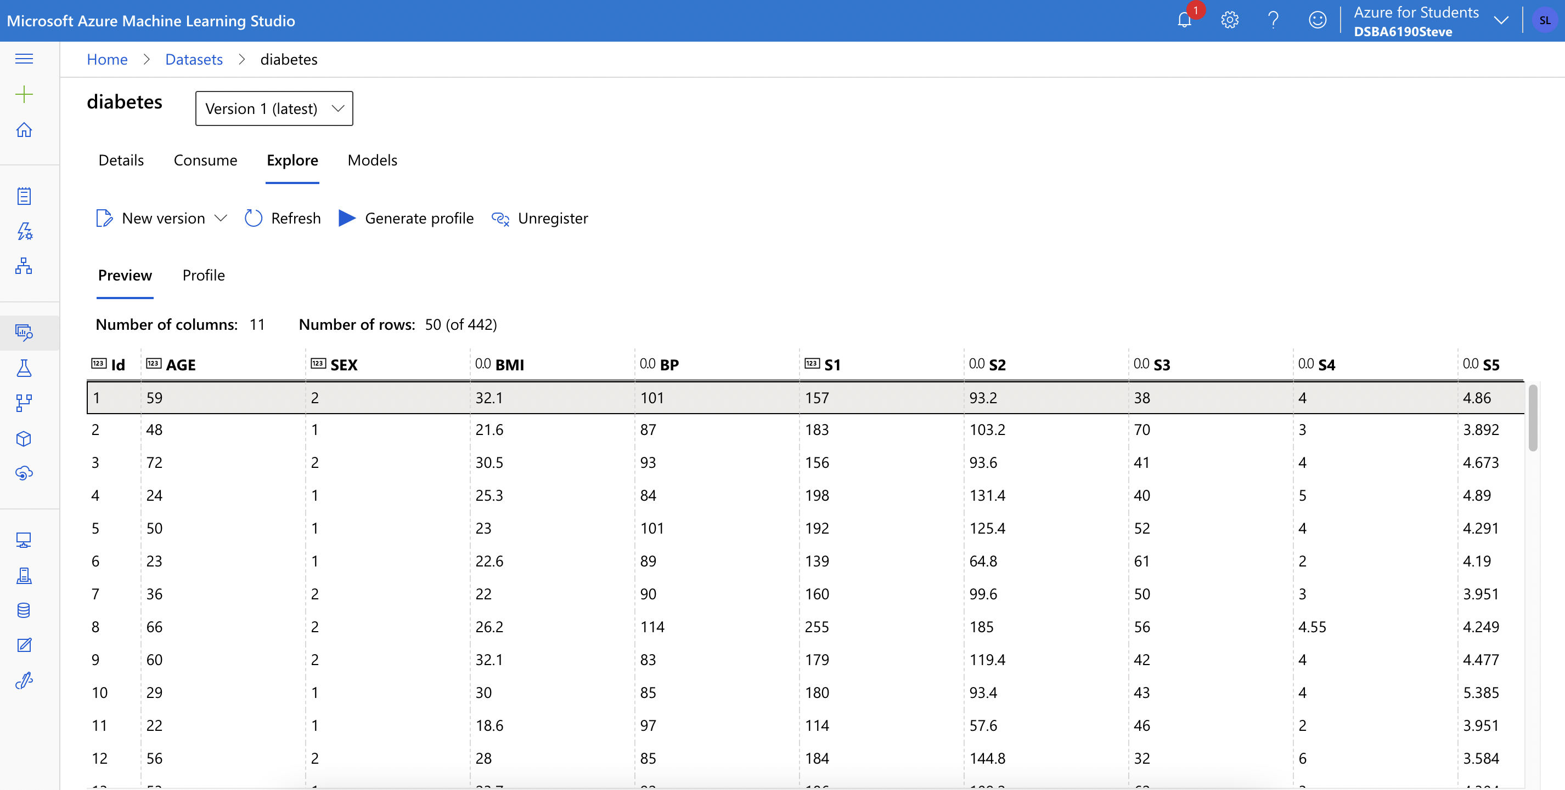
Explore Data

Slide 11
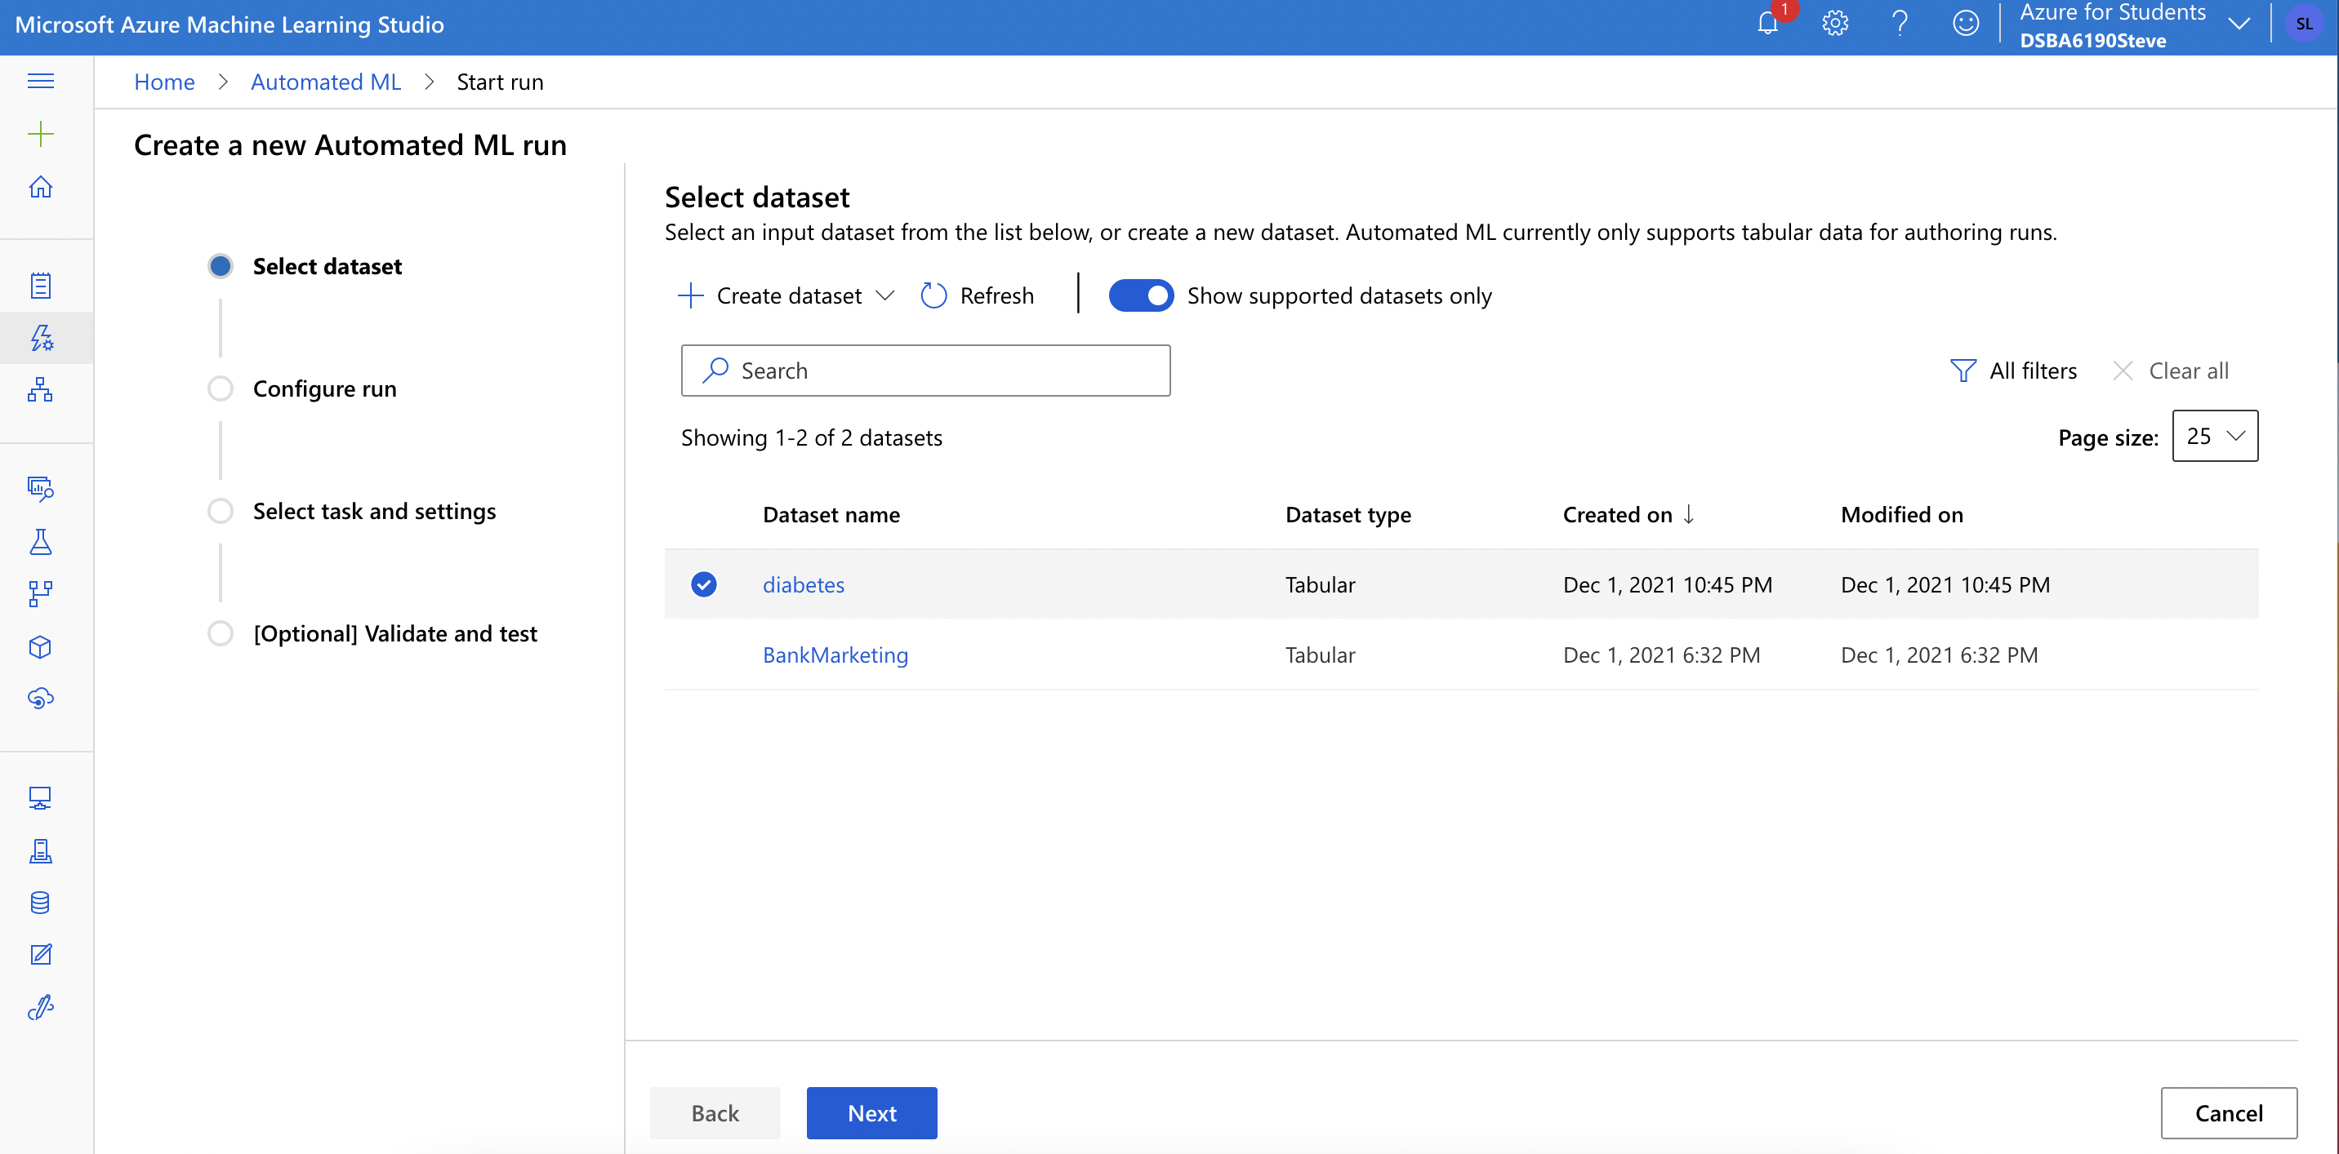
Train Model

Slide 12
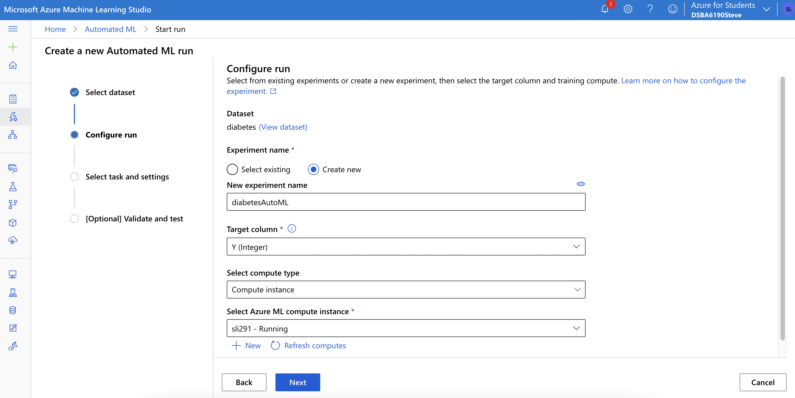
Train Model

Slide 13
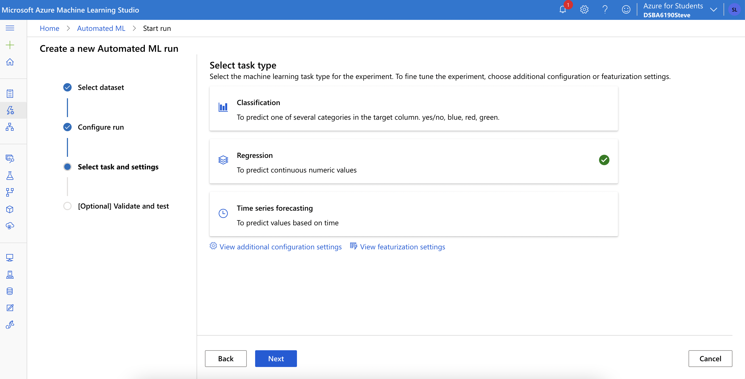
Train Model

Slide 14
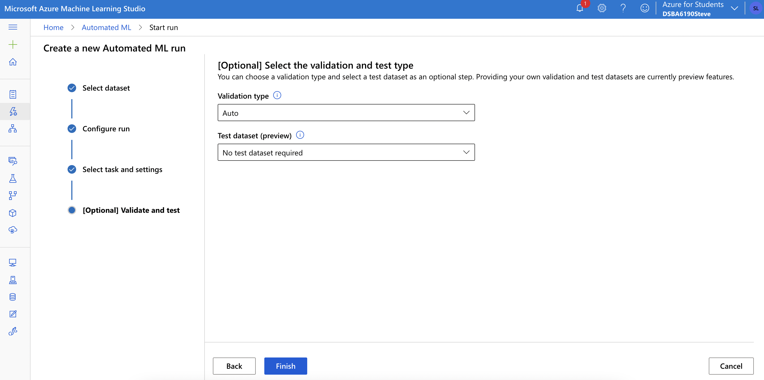
Train Model

Slide 15
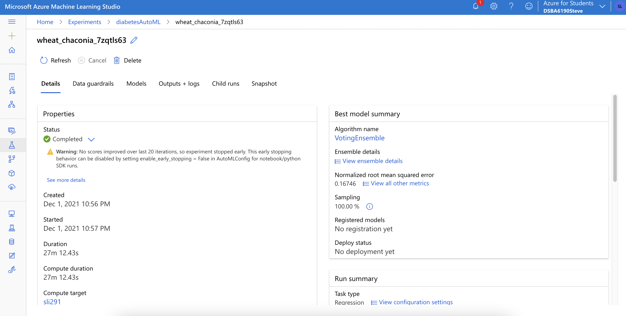
Complete Model Training

Slide 16
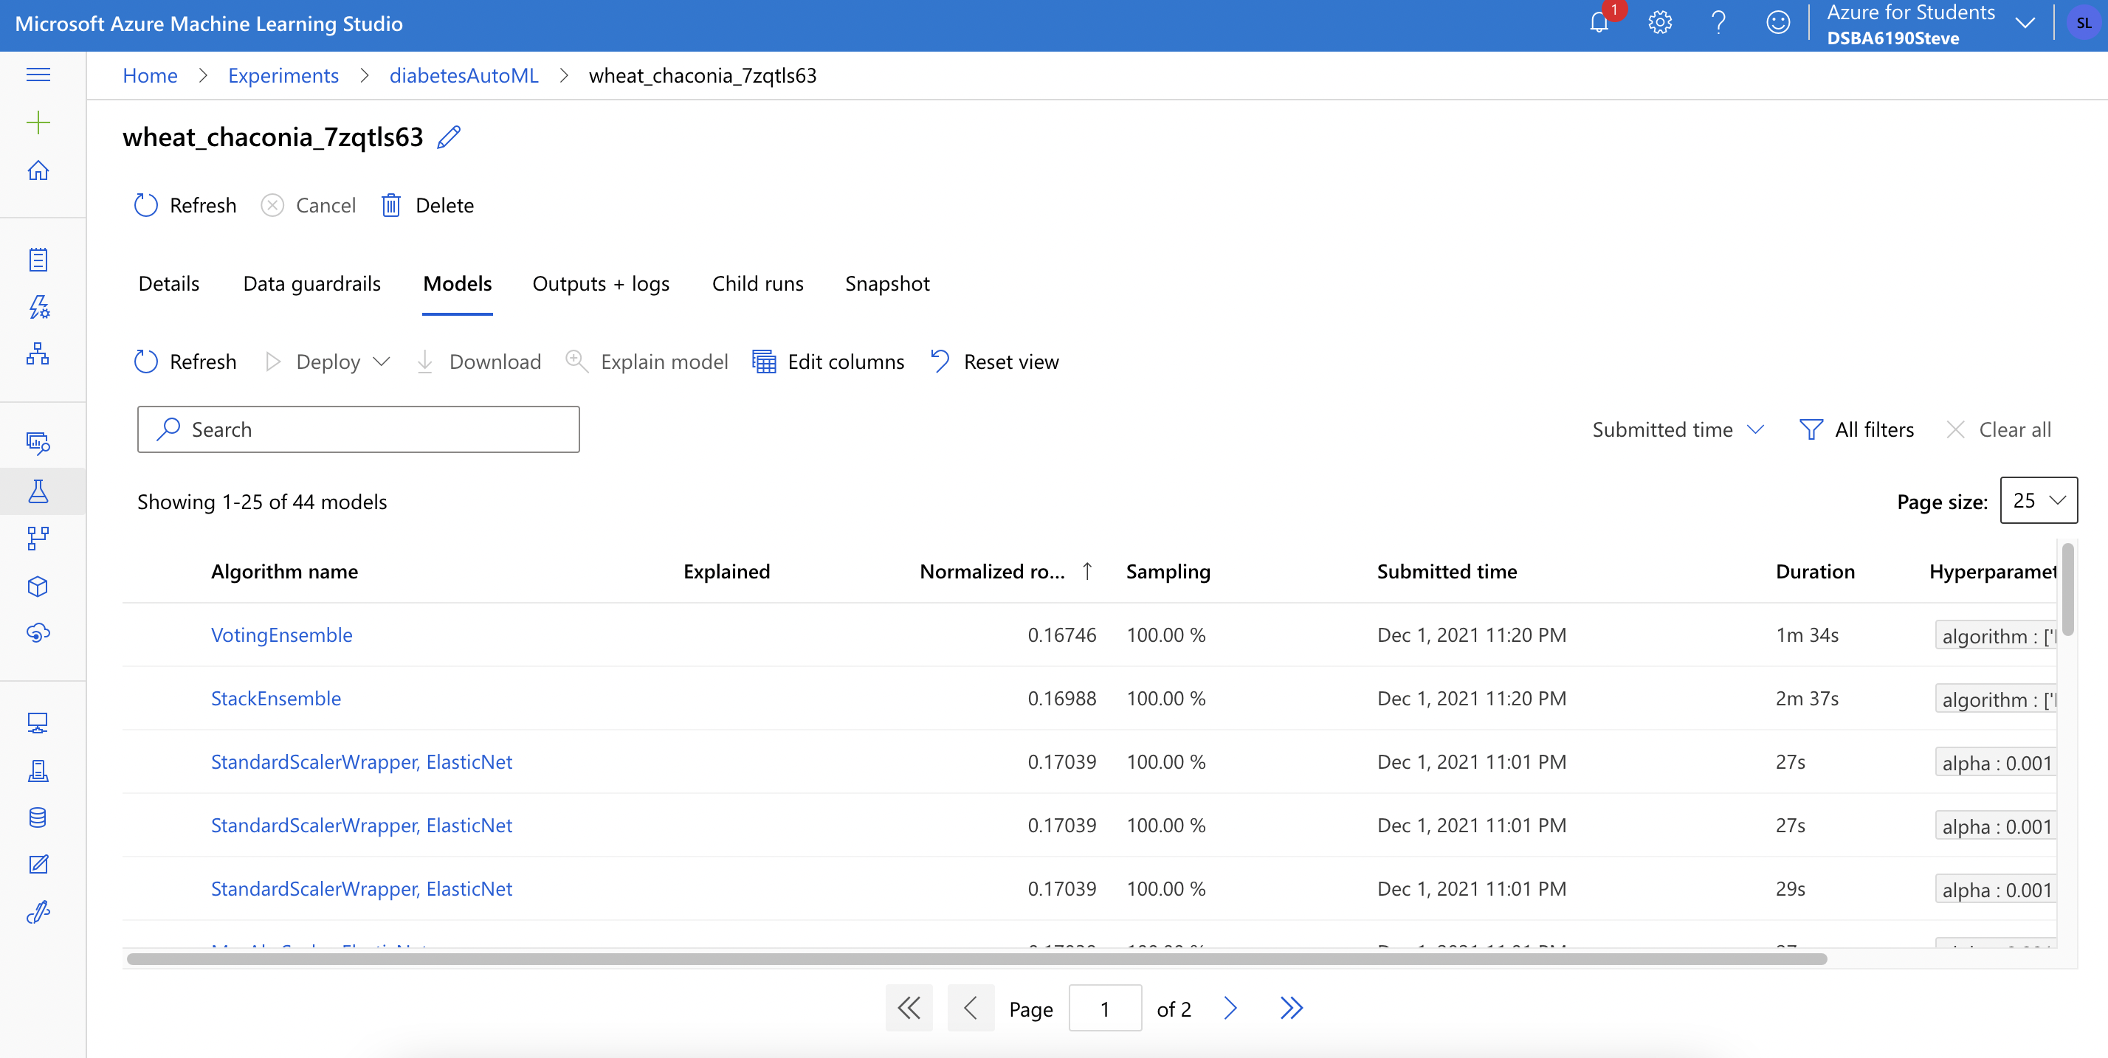
Trained Models

Slide 17
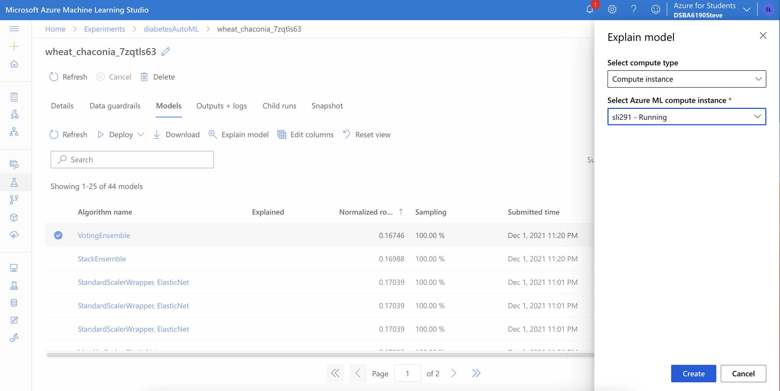
Explain Model

Slide 18
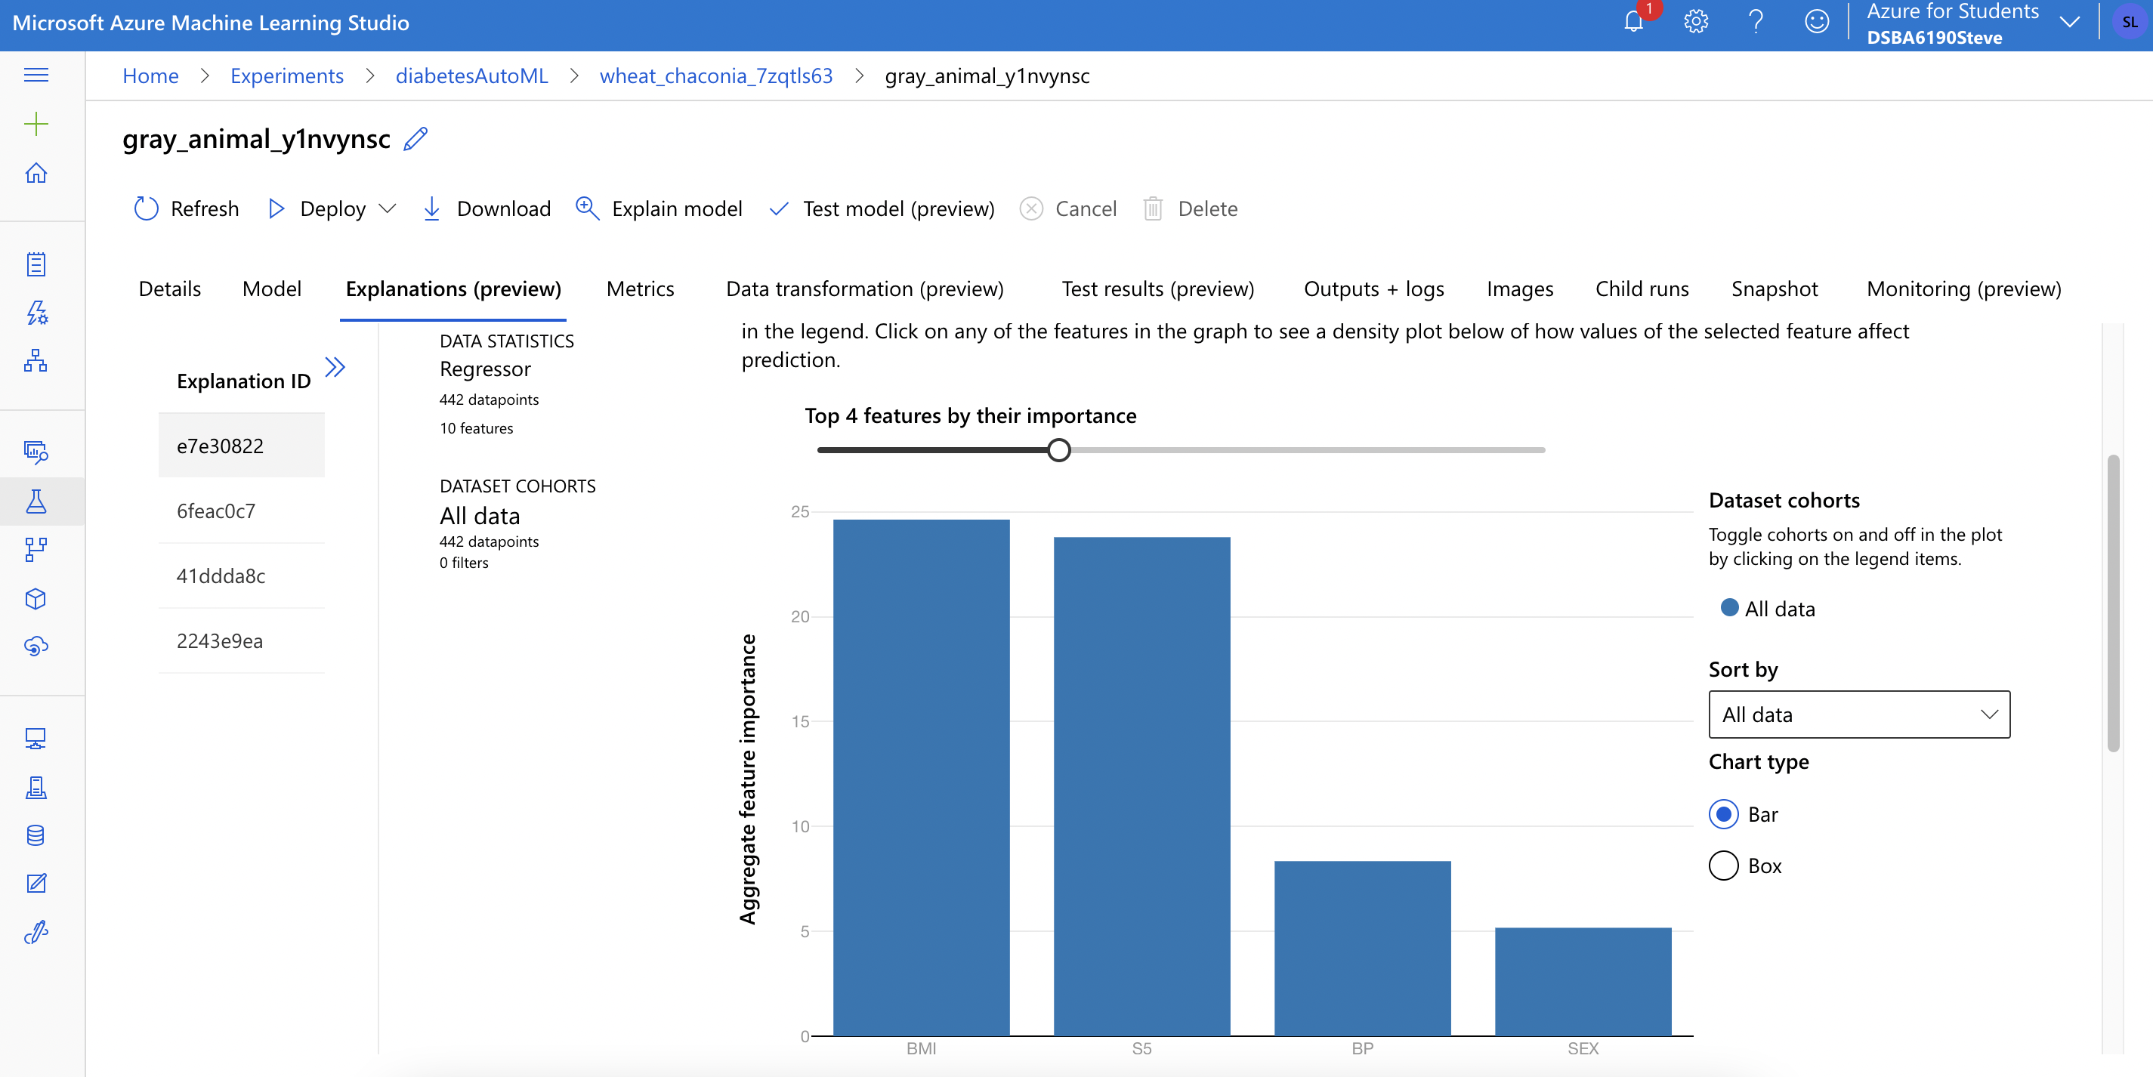
Explain Model – Feature Importance

Slide 19
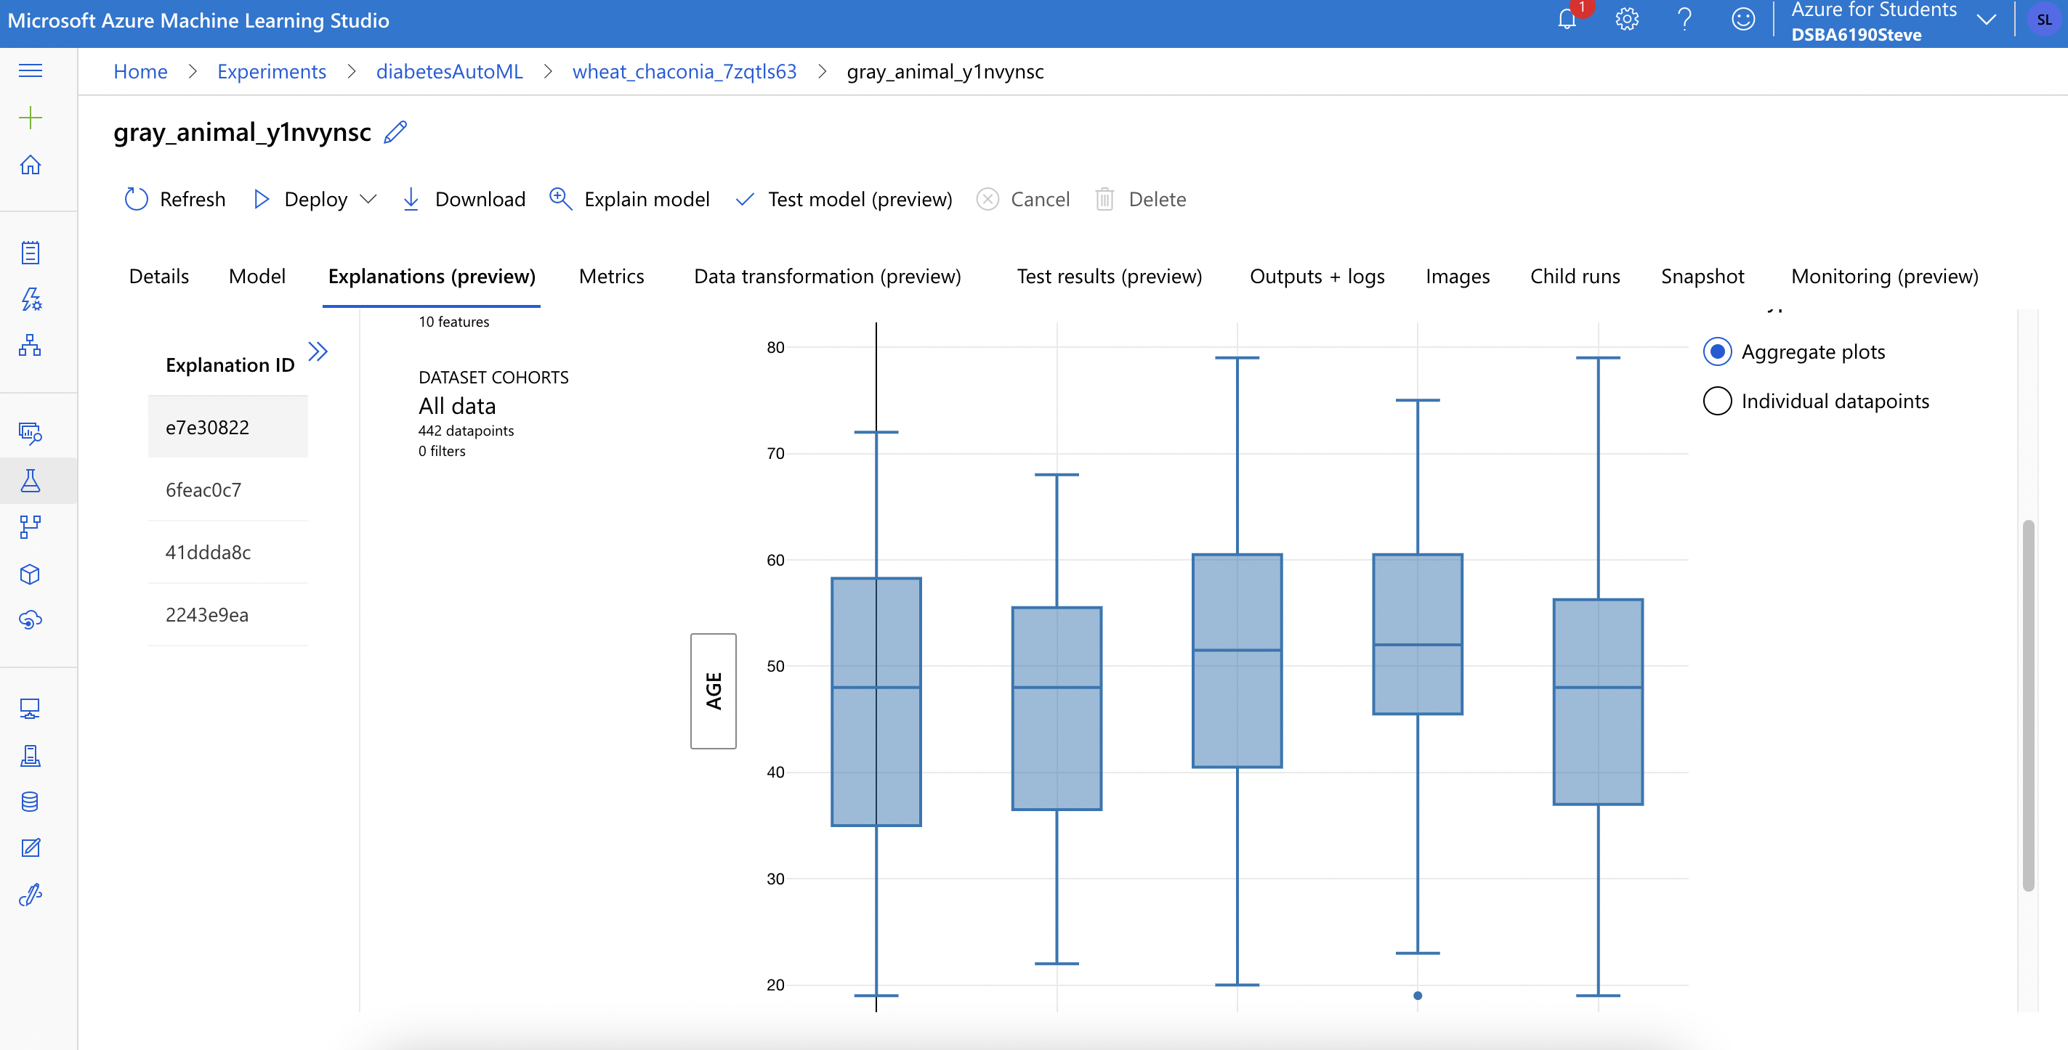
Explain Model

Slide 20
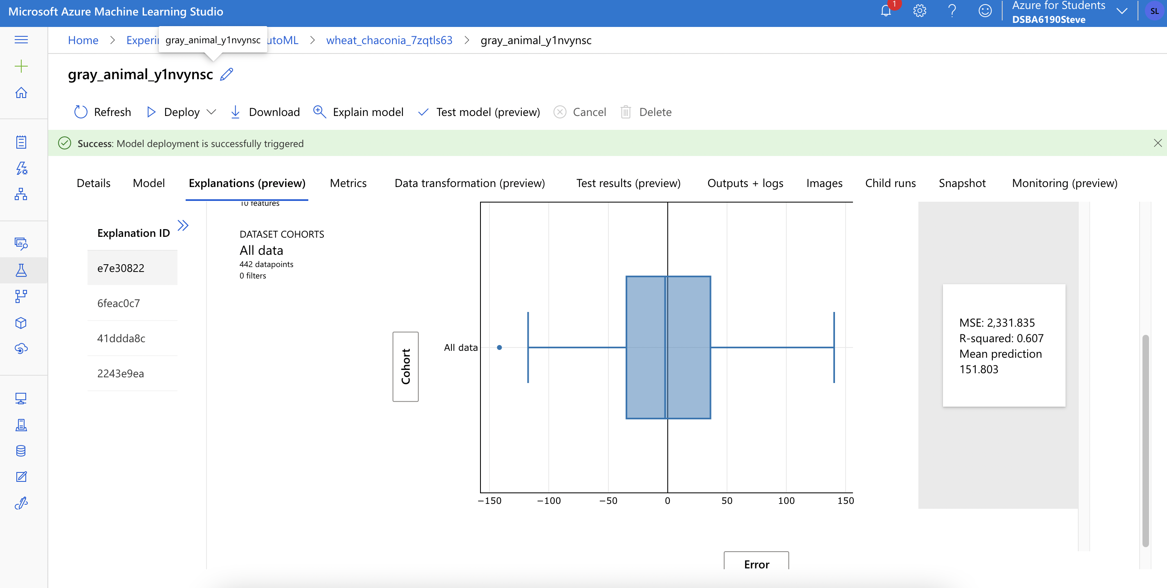
Explain Model

Slide 21
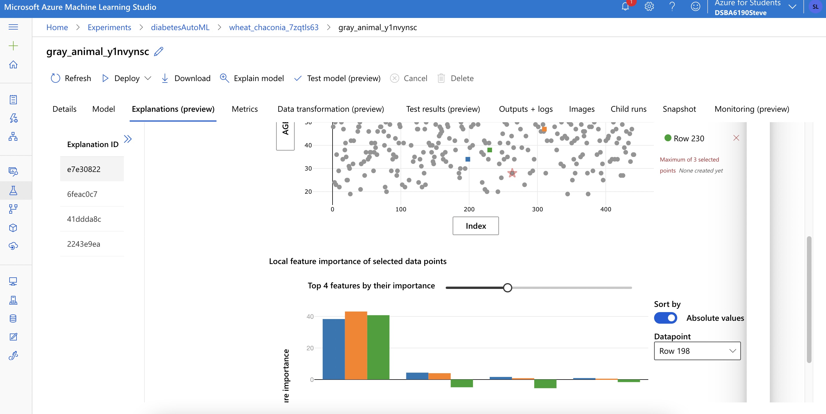
Explain Model

Slide 22
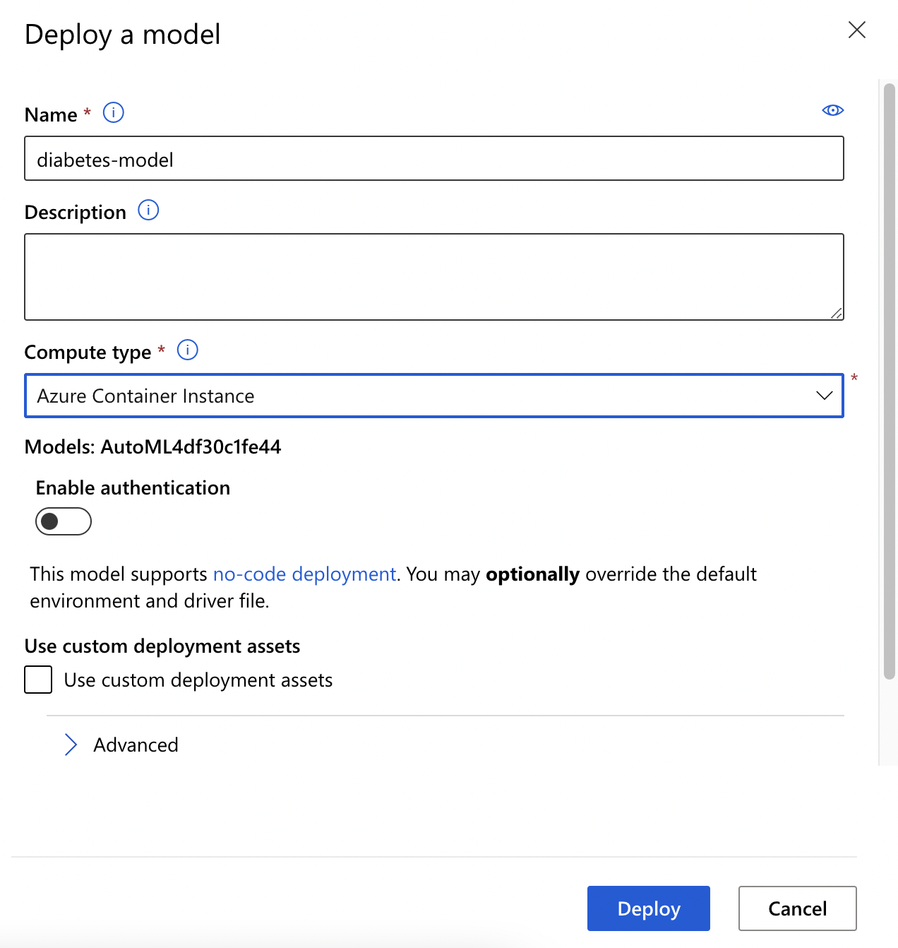
Deploy Diabetes Model

Slide 23
Consume Azure Machine Learning models in Power BI

Slide 24
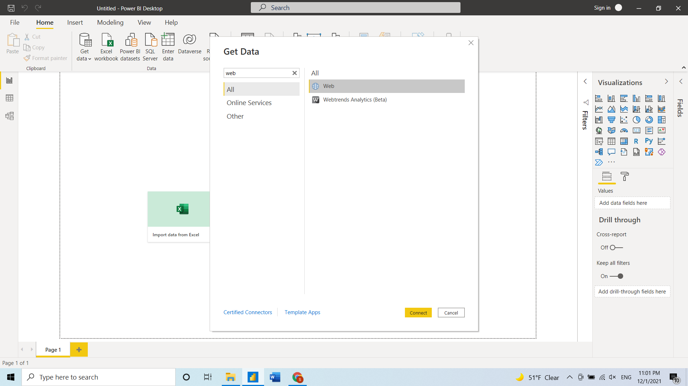
Download Online Test Dataset to Power BI

Slide 25
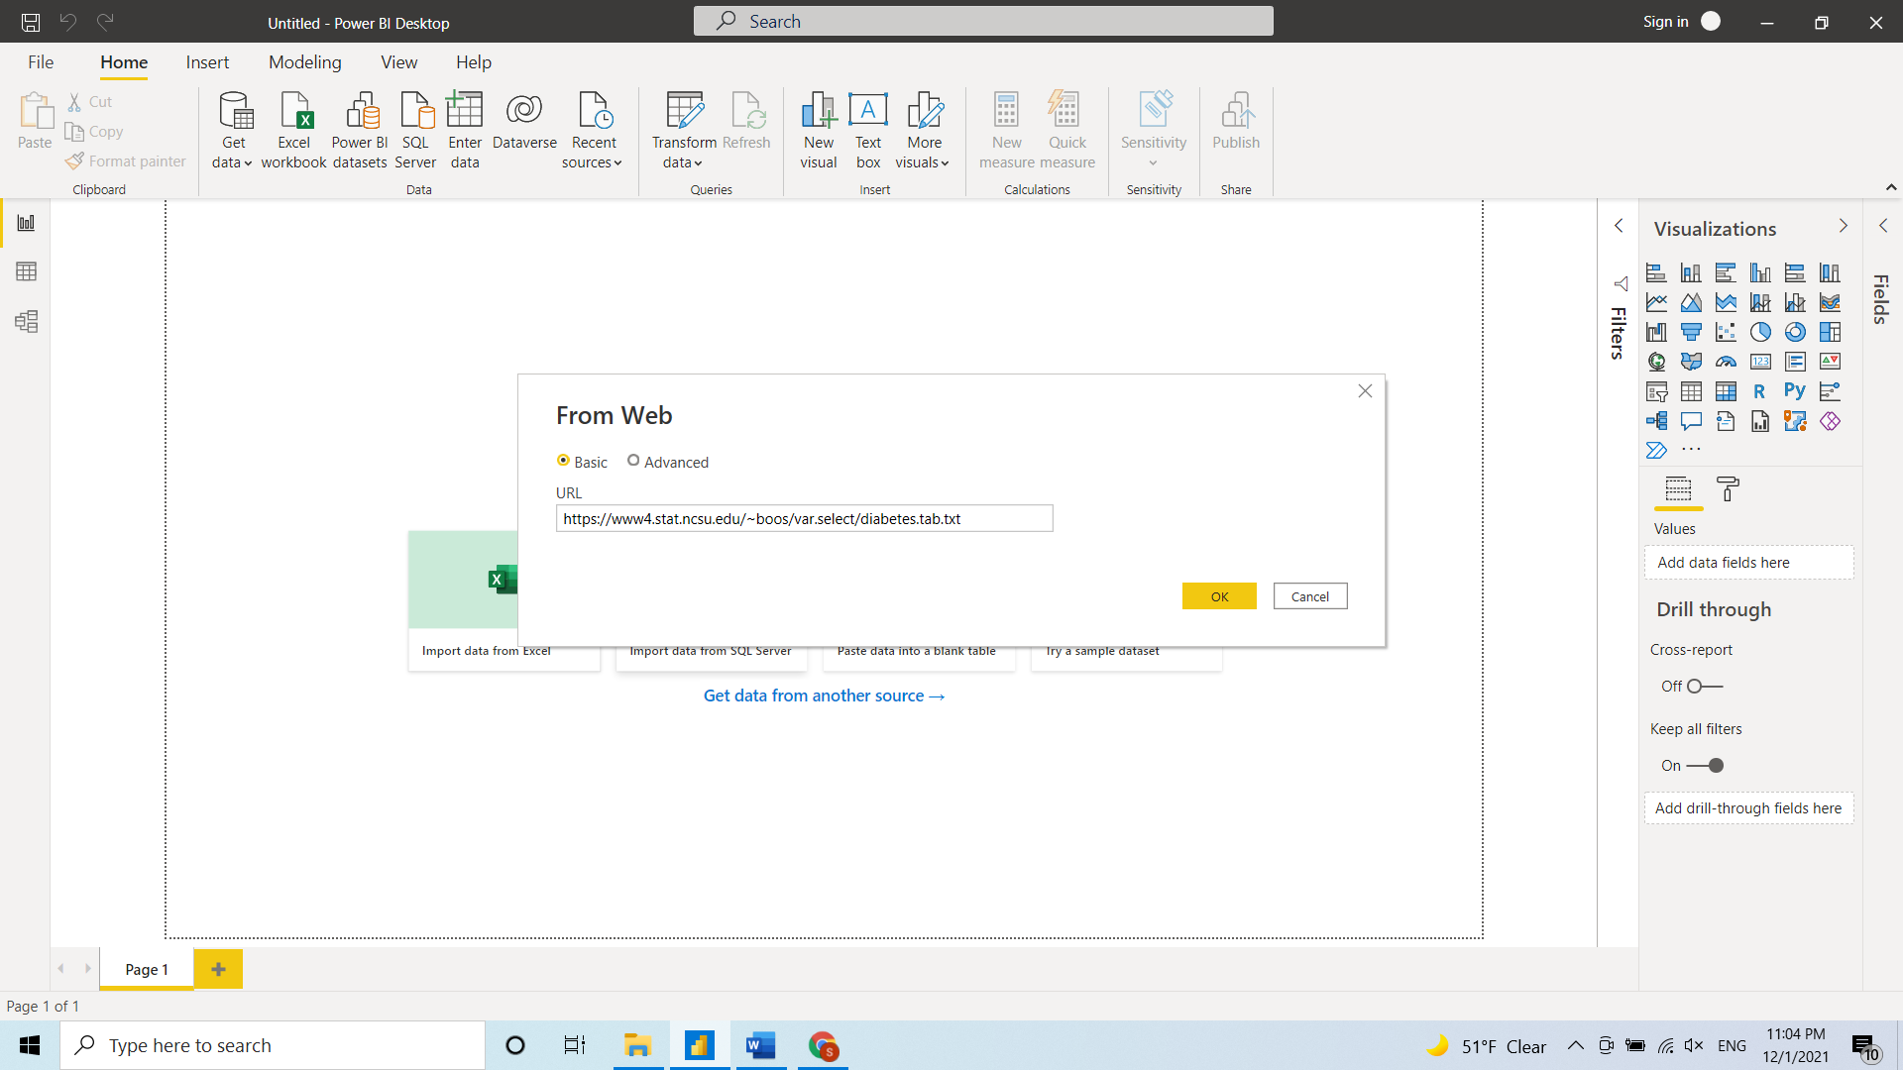
Download Online Test Dataset to Power BI

Slide 26
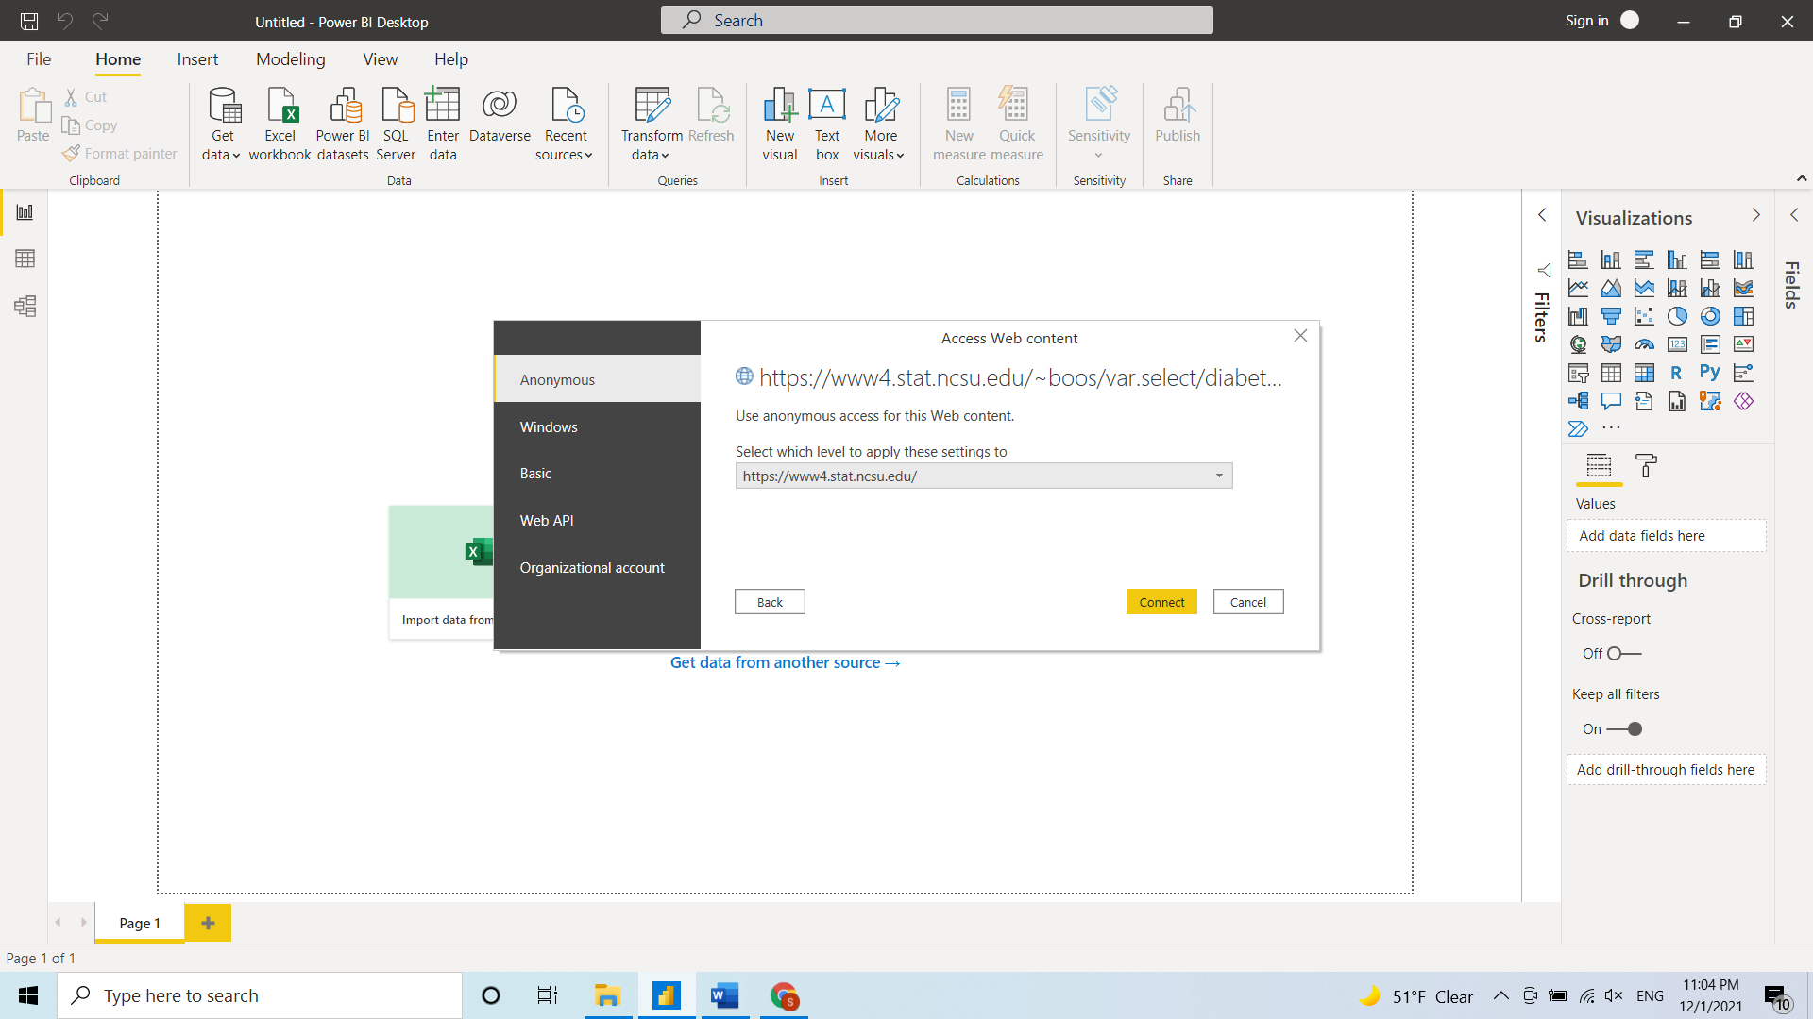
Download Online Test Dataset to Power BI

Slide 27
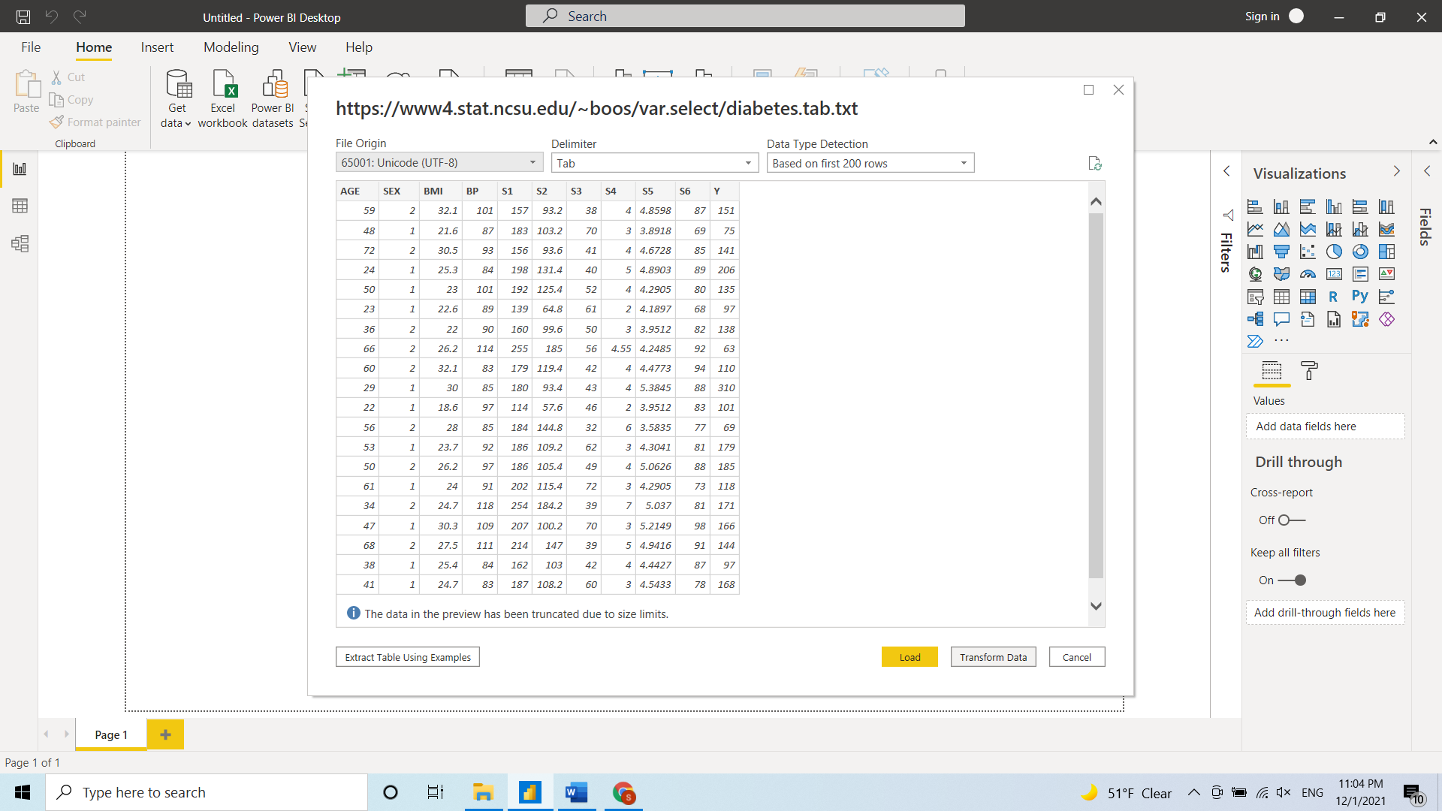
Transform Online Test Dataset to Power BI

Slide 28
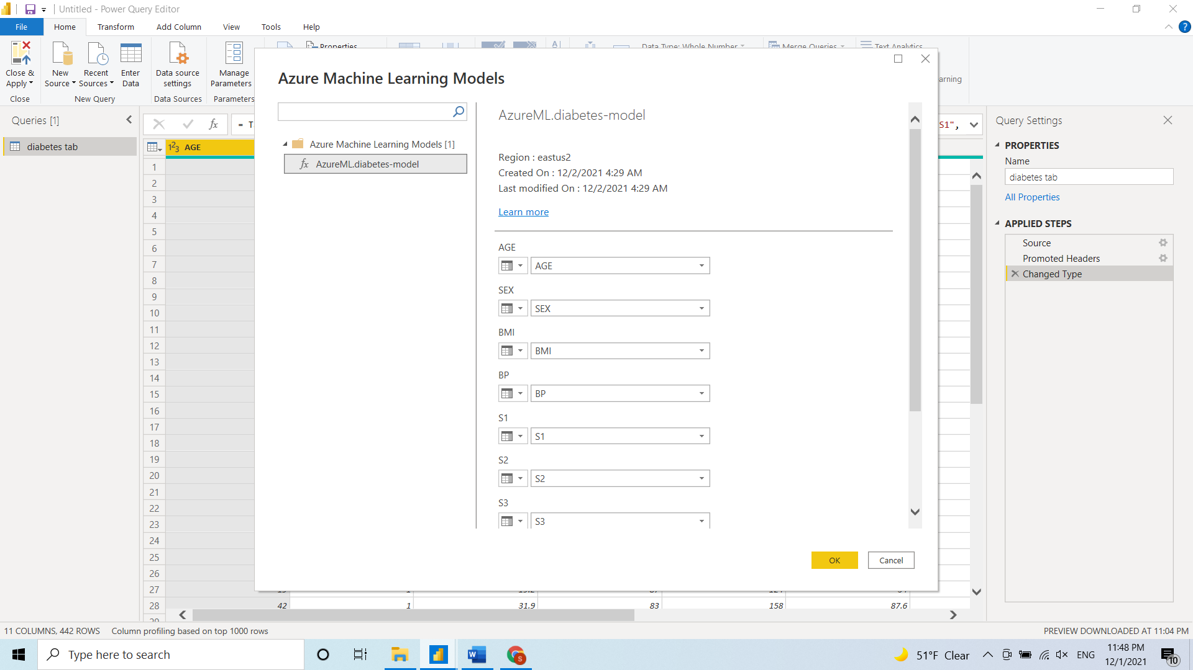
Score Diabetes Model in Power BI
Click Azure Machine Learning button

Slide 29
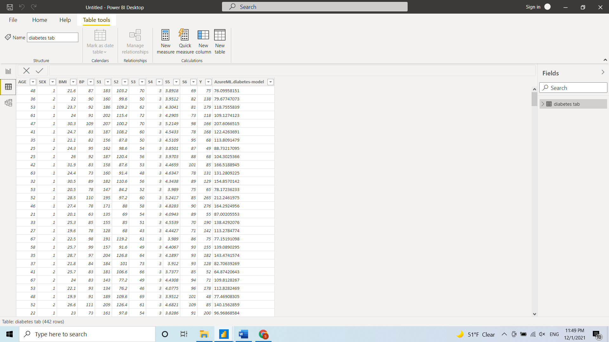
Diabetes Model Prediction Result

Slide 30
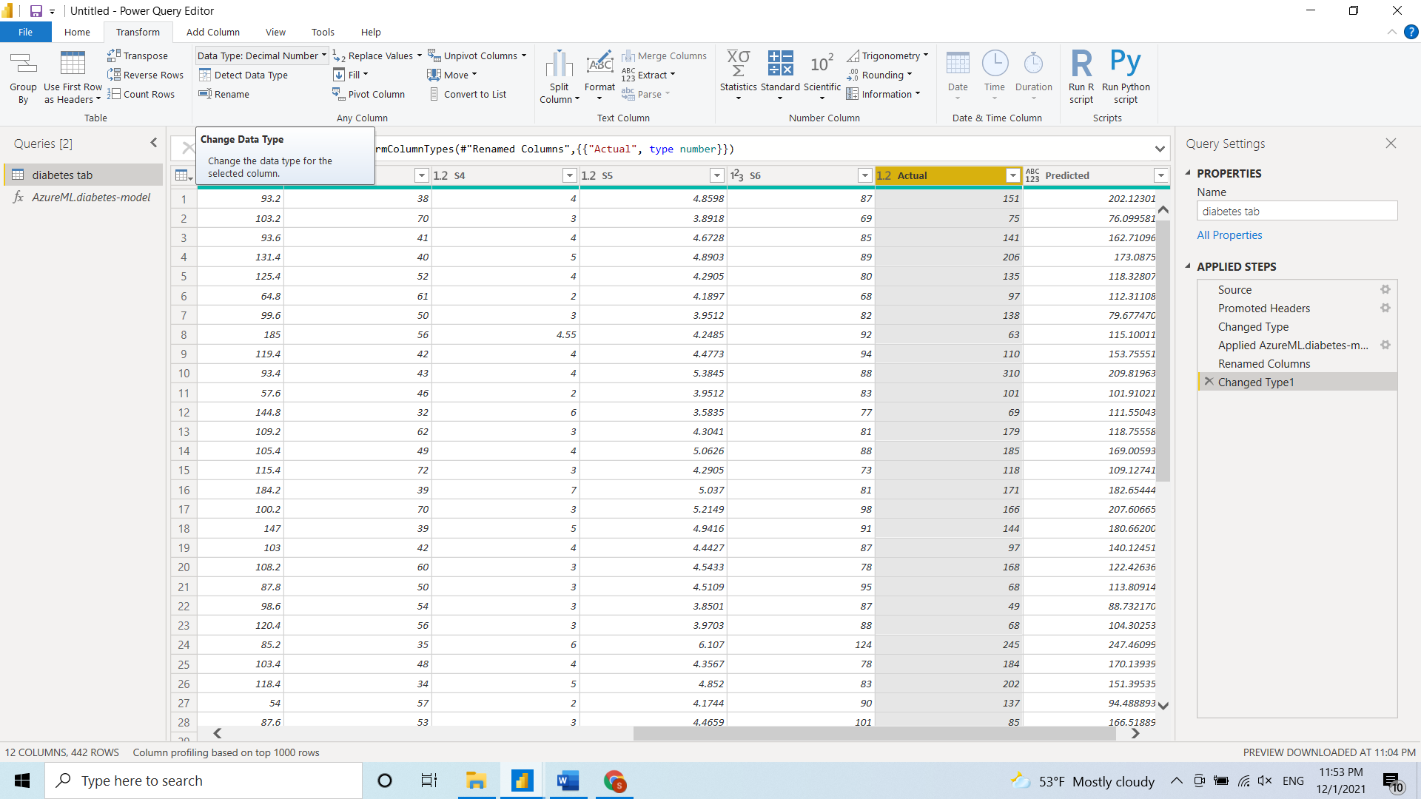
Rename to Predicted

Slide 31
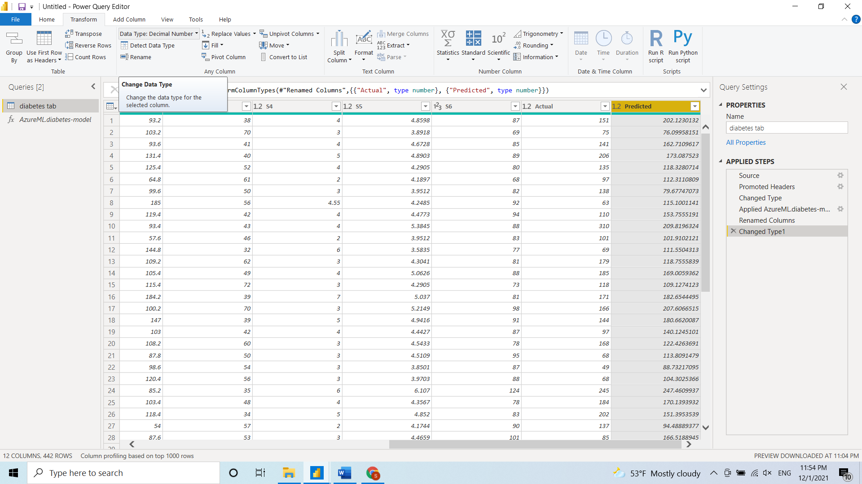
Change Data Type

Slide 32
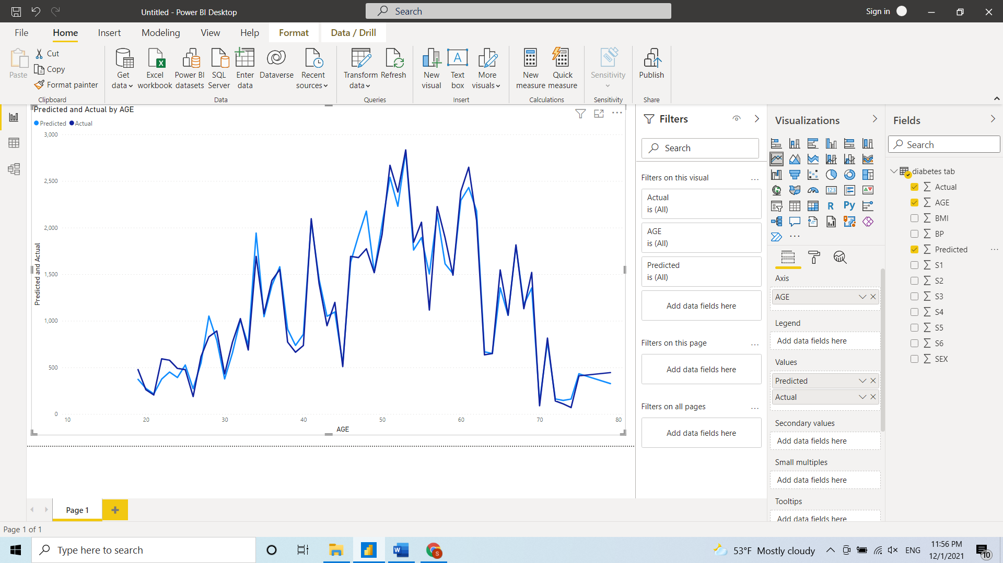
Plot Line Chart

Slide 33
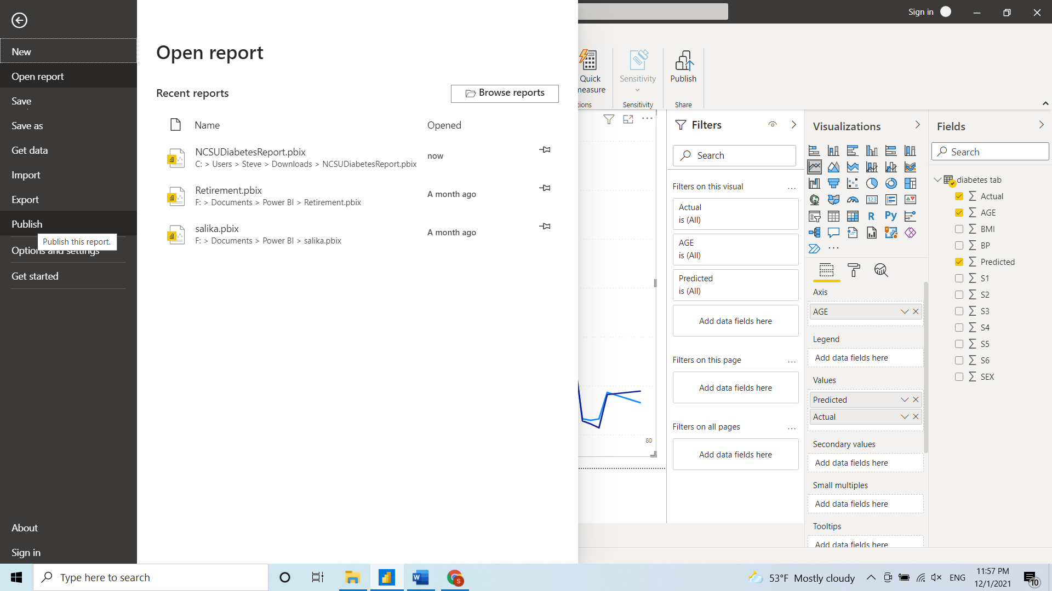
Publish Report

Slide 34
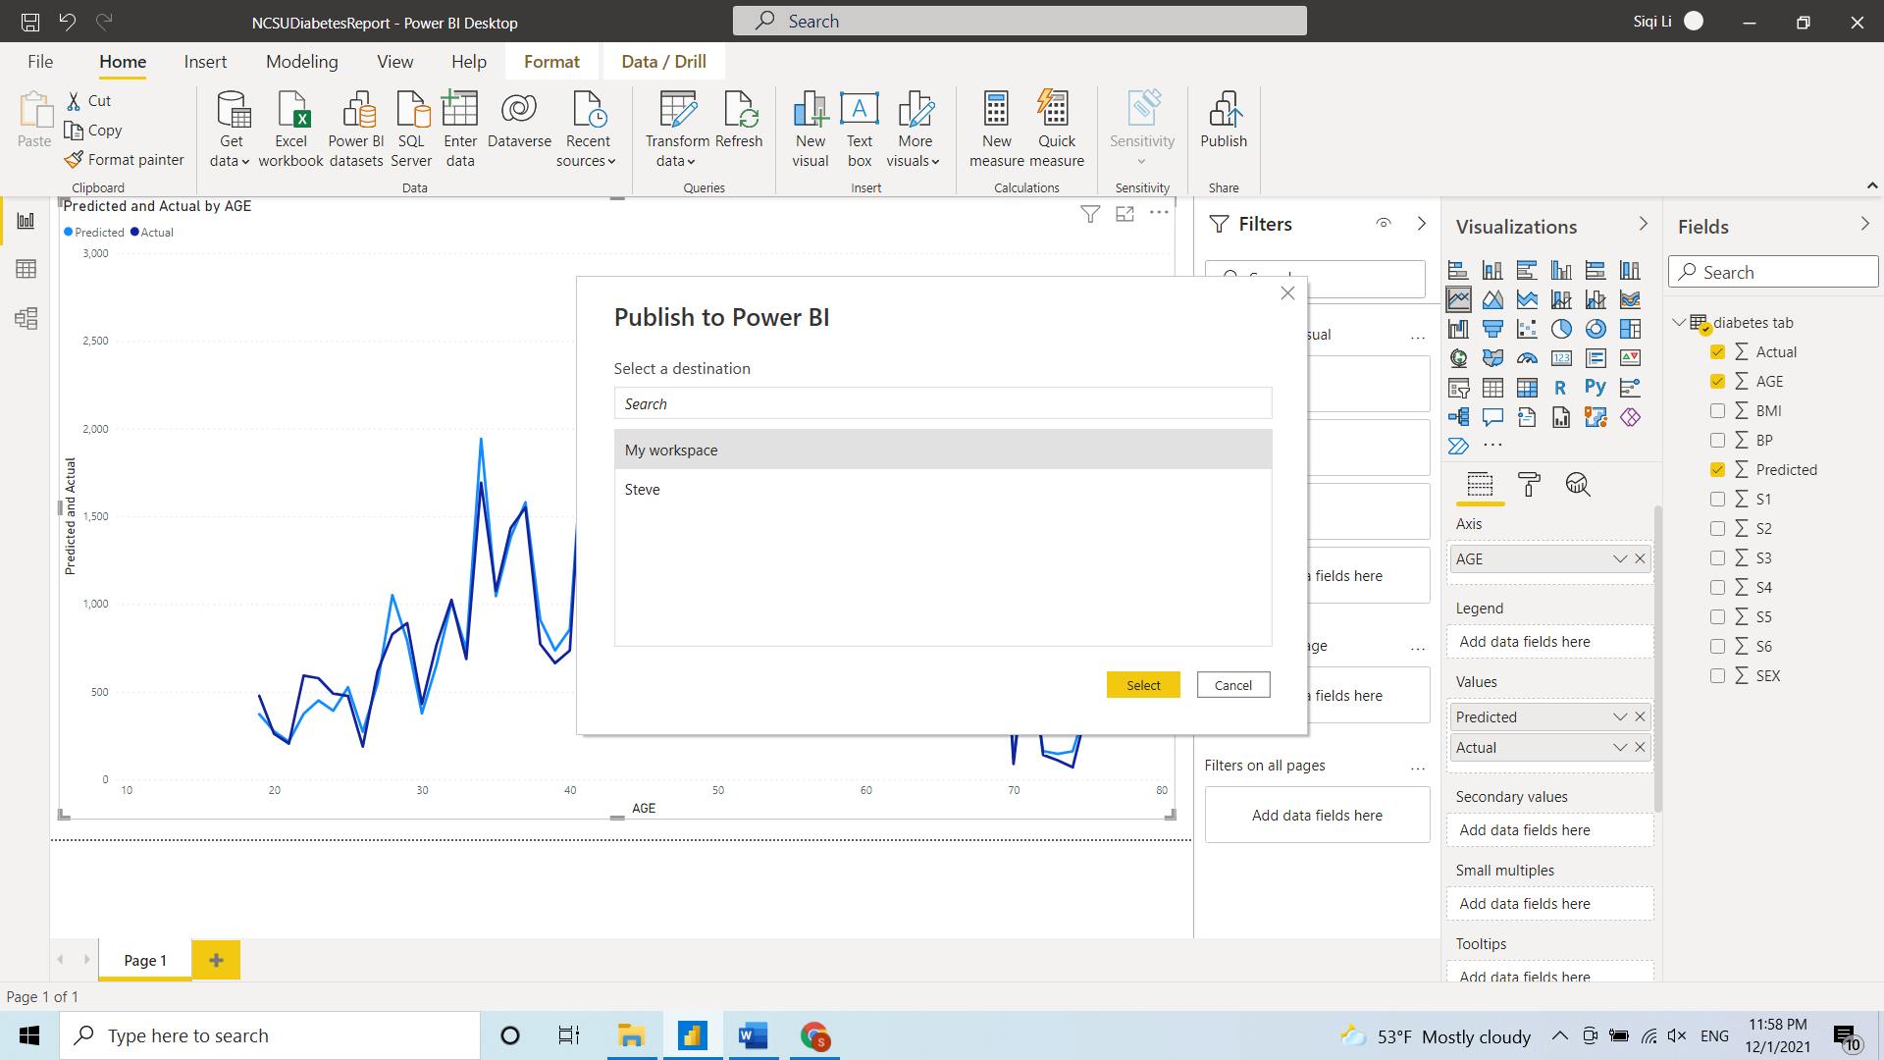
Publish Report

Slide 35
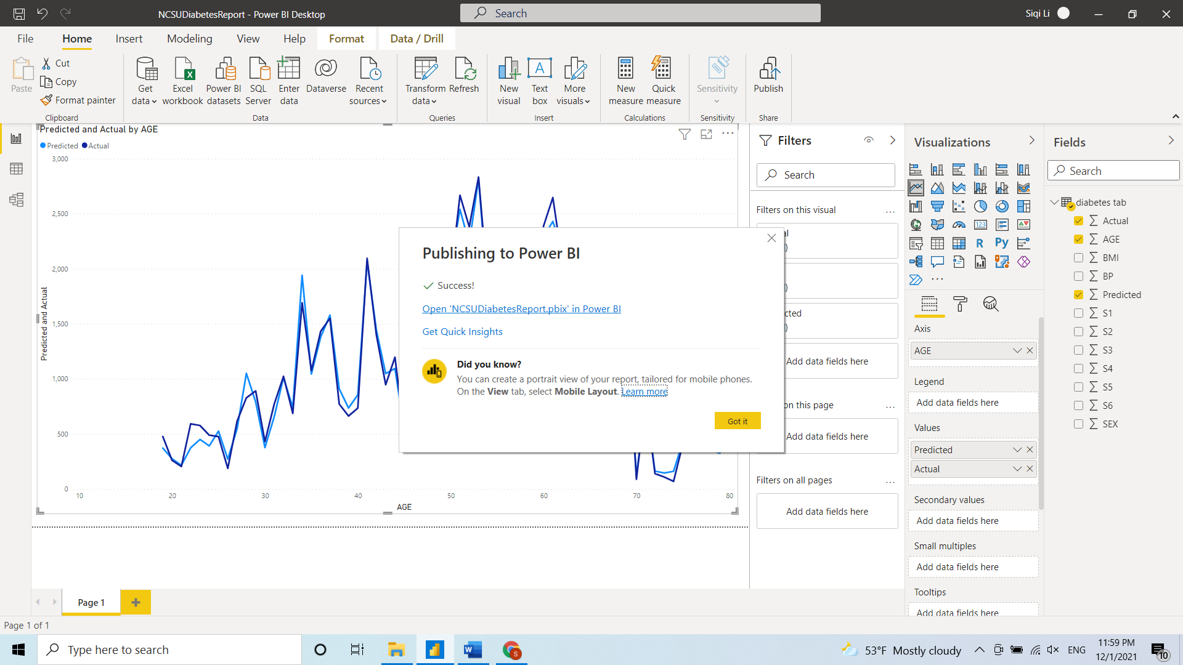
Publish Report

Slide 36
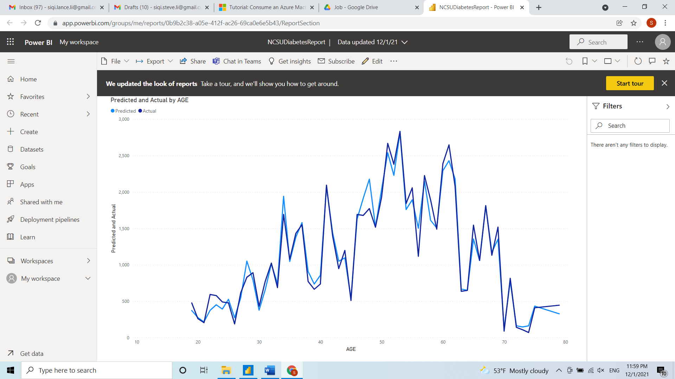
Report on My Workspace

Slide 37
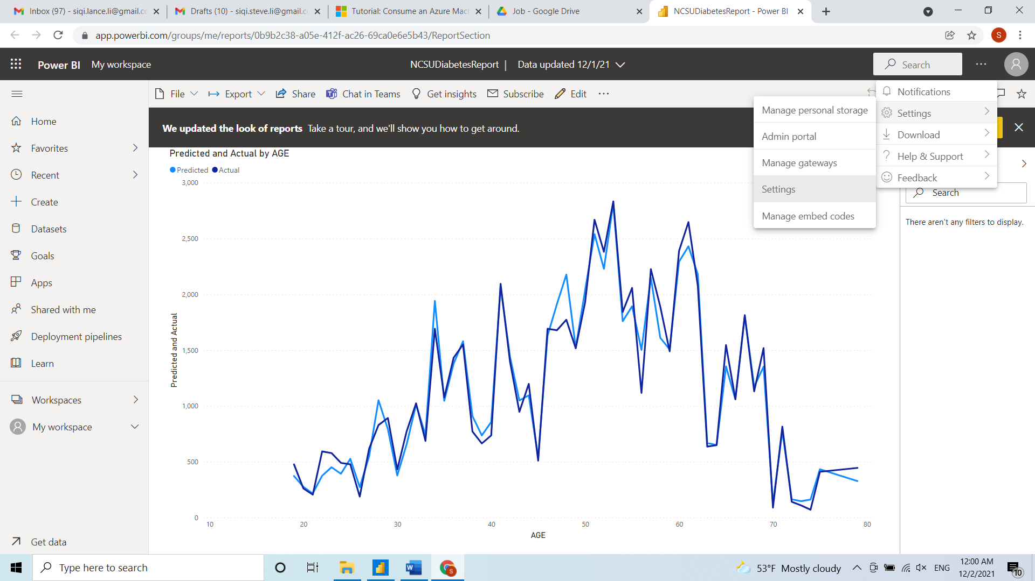
Schedule Report Refresh

Slide 38
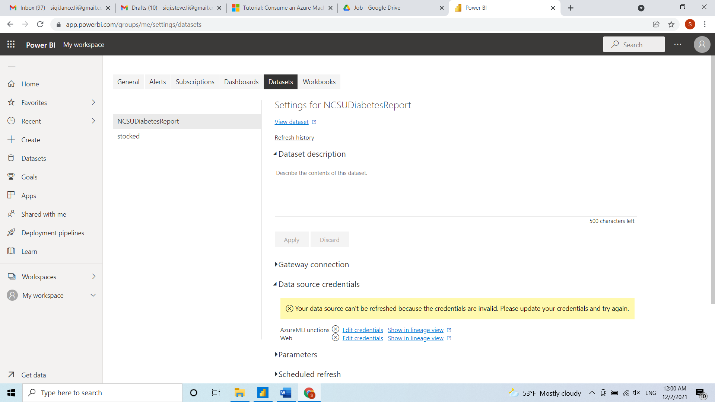
Schedule Report Refresh

Slide 39
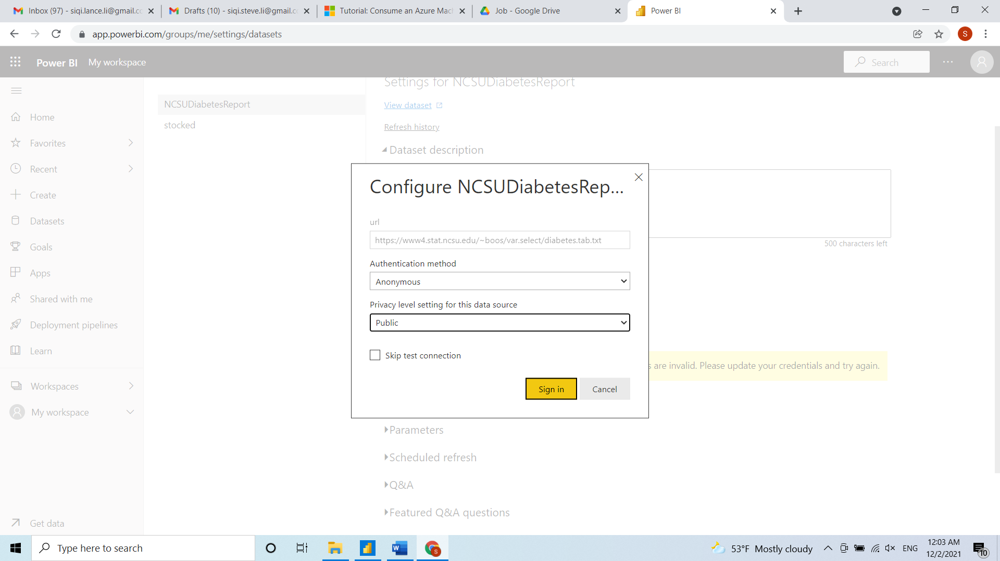
Schedule Report Refresh

Slide 40
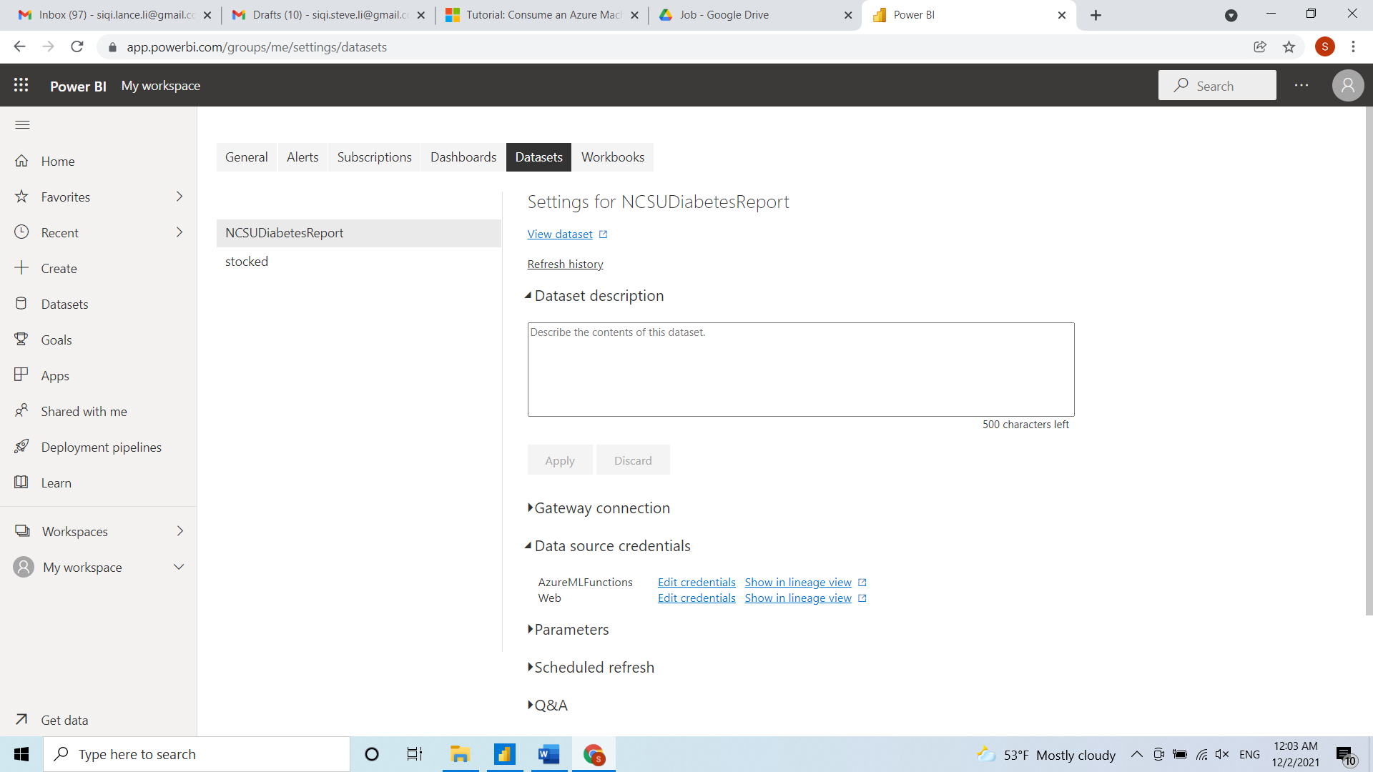
Schedule Report Refresh

Slide 41
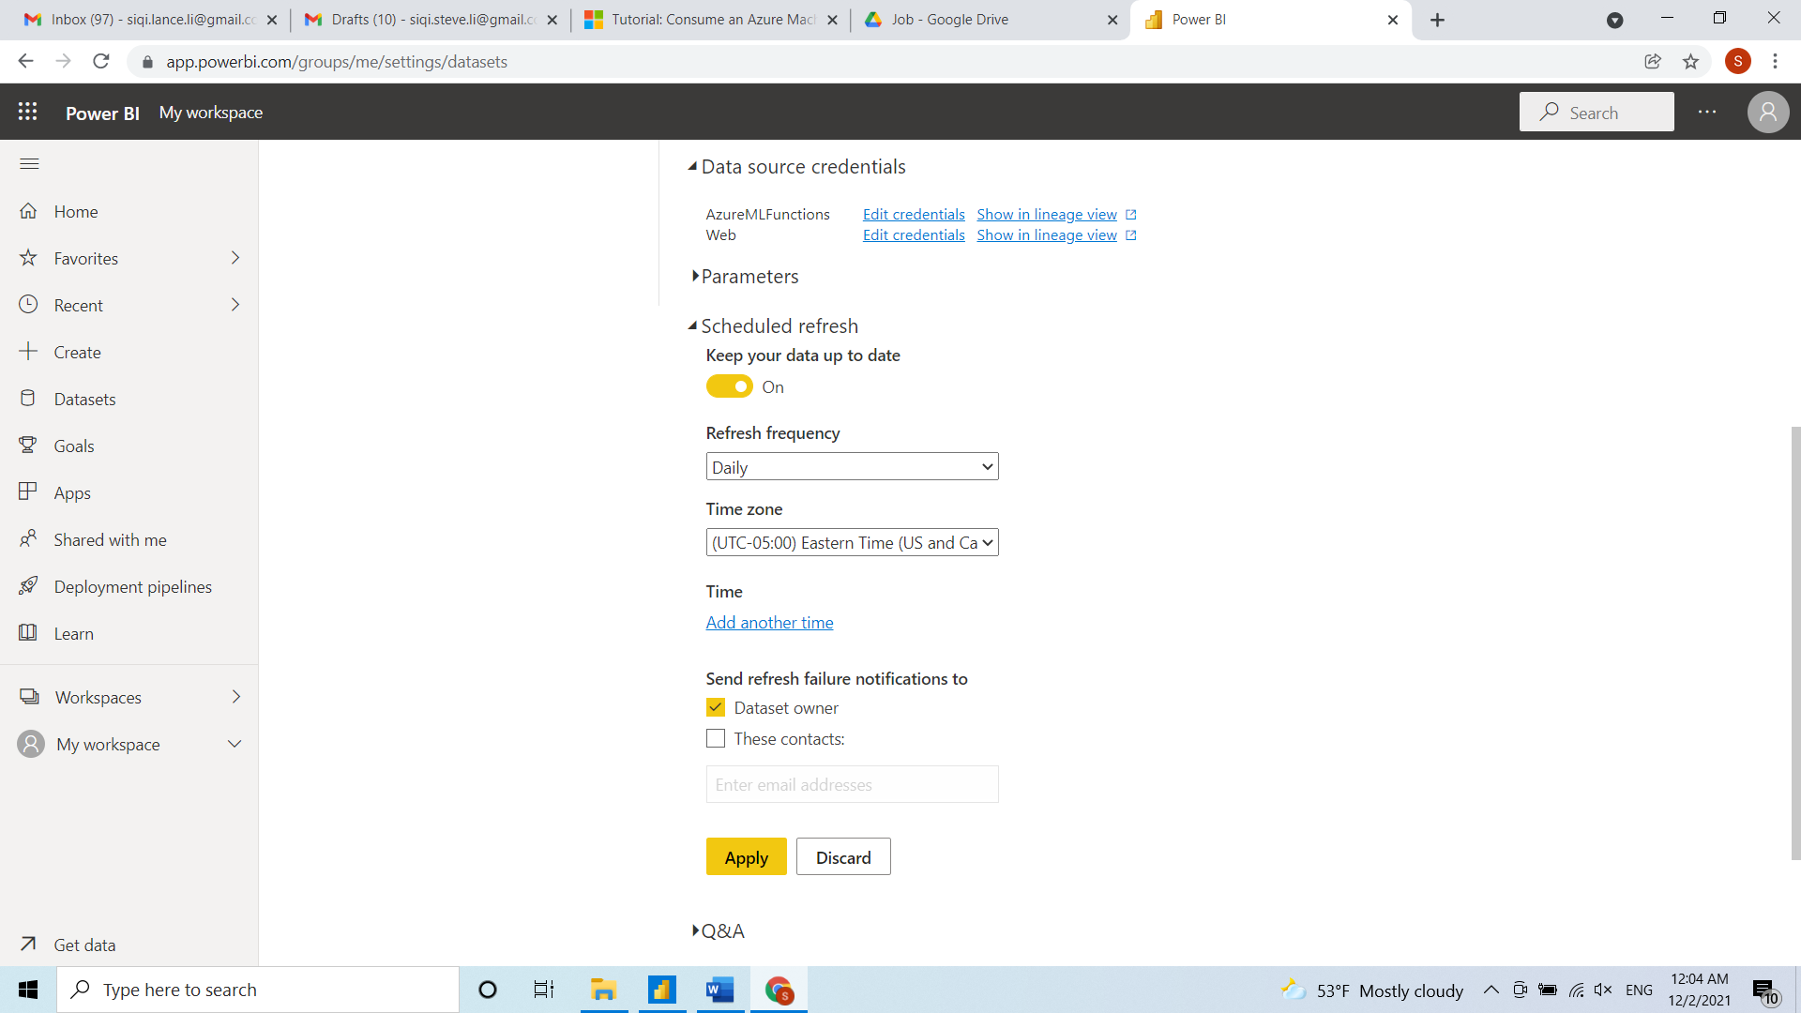
Schedule Report Refresh

